Slide 1


AH&MRC
CQI State Forum
MBS Presentation
5th June 2025

Slide 2

We acknowledge the Traditional Custodians of the land on which we gather today. We pay our respects to elders past, present, and emerging and recognise their enduring connection to land, waters, and culture.
We honor the resilience, wisdom, and strength of First Nations peoples and commit ourselves to learning from and walking alongside them, as we strive for a future of respect, equality, and reconciliation.
In the spirit of togetherness, we stand united in honoring the culture and contributions of Aboriginal and Torres Strait Islander communities, now and always.
Notes:
Kim – Medicare

Slide 3
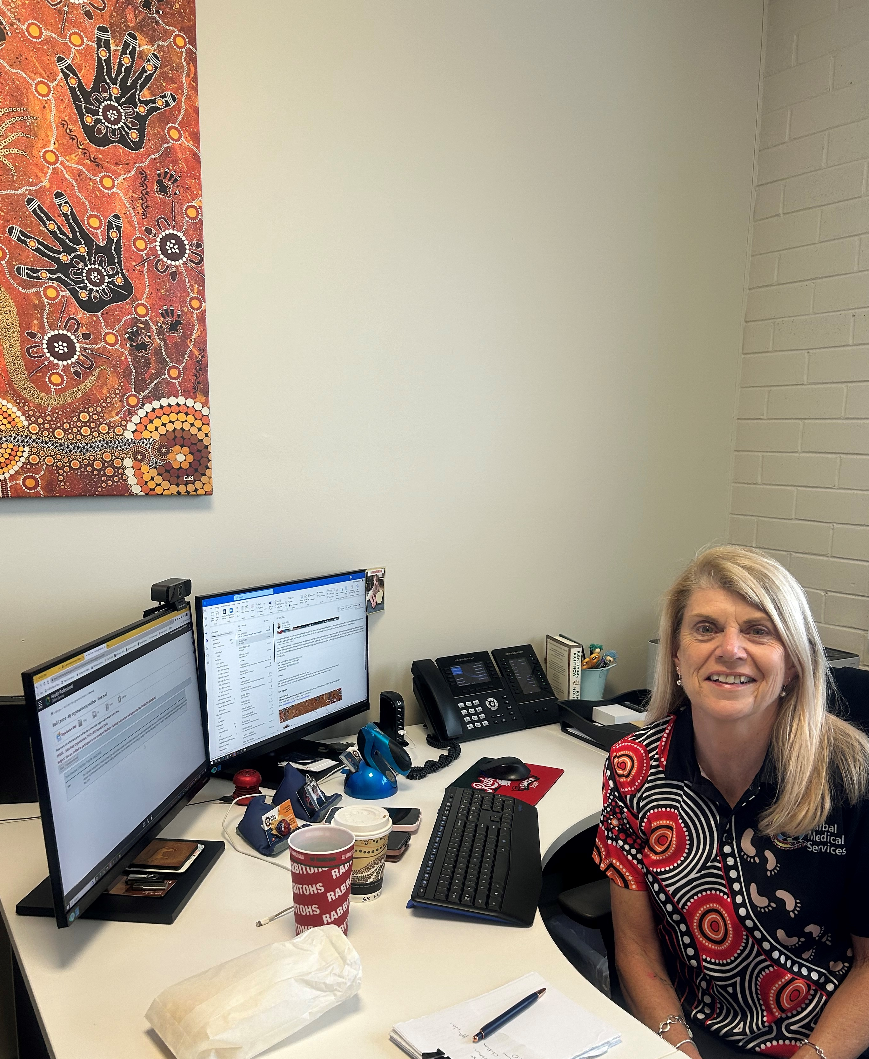
Introductions
Kim Passante
Project Lead
MBS National Coordinator
NACCHO
Notes:
Introduction, 25 years in health, 10 years in an AMS. Worked for the private sector as well as government organisations.
Strengths; Medicare, General practice and accreditation.

Slide 4

Want to know more
Questions
Challenges
Where to find more information
Notes:
At the end of the presentation you will have an opportunity to ask questions, tell me about your challenges and I will be able to help you find more information.

Slide 5
MBS Project – what is this ?
Project purpose
Creating financial sustainability
Extending services – not about making money
Notes:
The MBS optimisation project was developed to optimise the MBS and PIP claiming practices across the ACCHO sector.
We needed to increase knowledge and improve efficiency of the MBS and PIP claiming and to also improve MBS data.
By creating an online training program we are able to share this knowledge across the nation, with no limitations.
The project is about creating financial sustainability for the ACCHO sector and extending services to our patients,
If you do the work, then you should be billing the items.

Slide 6
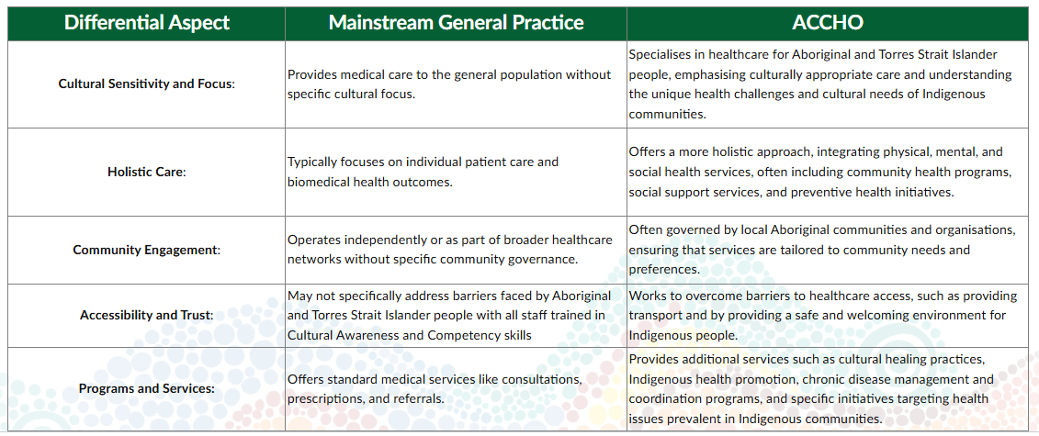
Why are ACCHOS different to General Practice

Slide 7
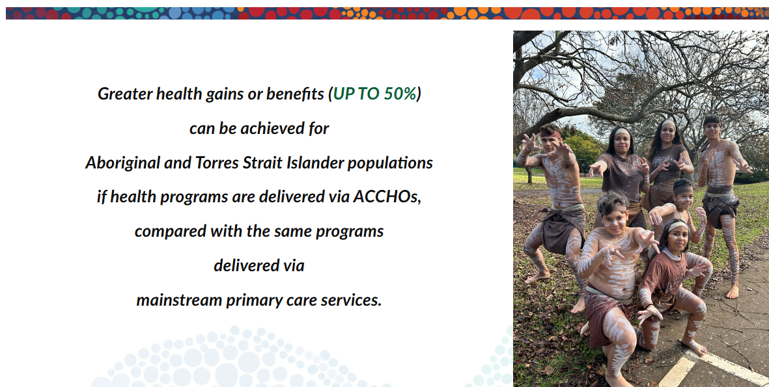
Notes:
We know that we have better health outcomes through ACCHO services.

Slide 8
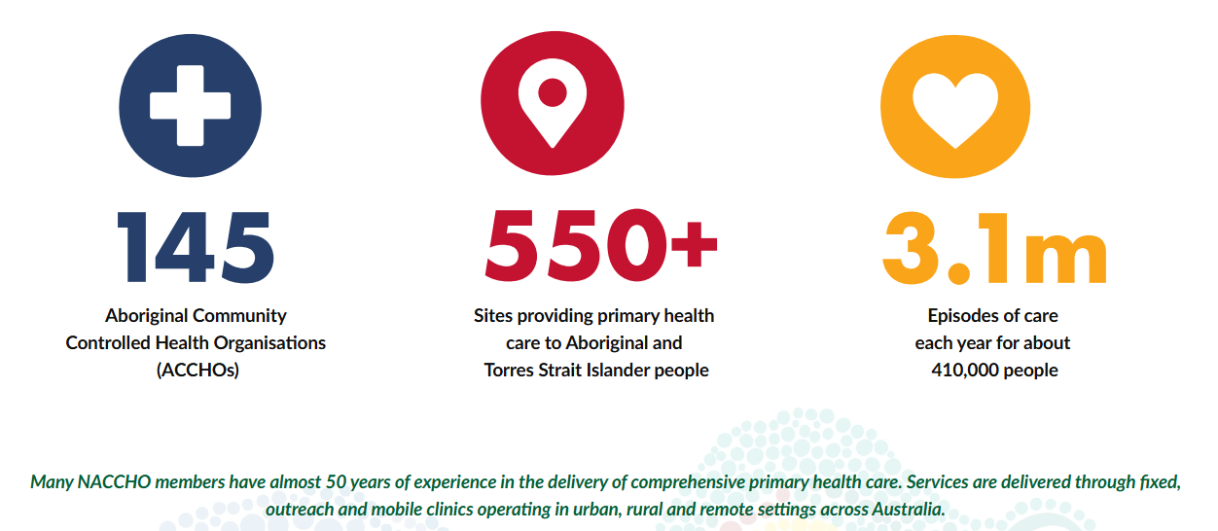
ACCHOs Statistics
Notes:
Statistics - NACCHO member services have almost 50 years of experience in delivering PHC

Slide 9
Online Learning Courses
4 Courses; Developed with an Expert Reference Group
  MBS in ACCHO’s
  PIP in ACCHO’s
  ACCHO Orientation
  nKPI’s
    MMeX, Best Practice, Communicare, Medical Director
Notes:
The courses were developed to ensure that it was available to all services across the nation.
We developed 4 courses - The four areas that are covered are …

Slide 10
How will this help an ACCHO Sector?
Resource with live updates
Tool for engagement
Offering CPD Hours; RACGP/ ACRRM/ NAATSIHWP
Support you and increase your knowledge
Building Sector Capacity
Engaging and asking questions

Slide 11
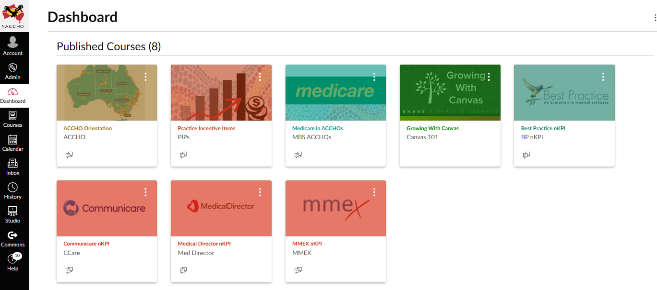
What is Canvas
Learning management system
University’s
Interactive
Data capture
Accessible online
Live updates

Slide 12
CANVAS Demonstration
Demonstration NACCHO Website
  Login
  Navigation
  Dashboard
  Sign Ups
  Support
Notes:
Sign ups are through the NACCHO website - main screen, Online Learning, scroll to the bottom, Register here or login.
URL: Log In to Canvas (instructure.com)
Login: kpassante@carbal.com.au
Password: Passante2023

Slide 13
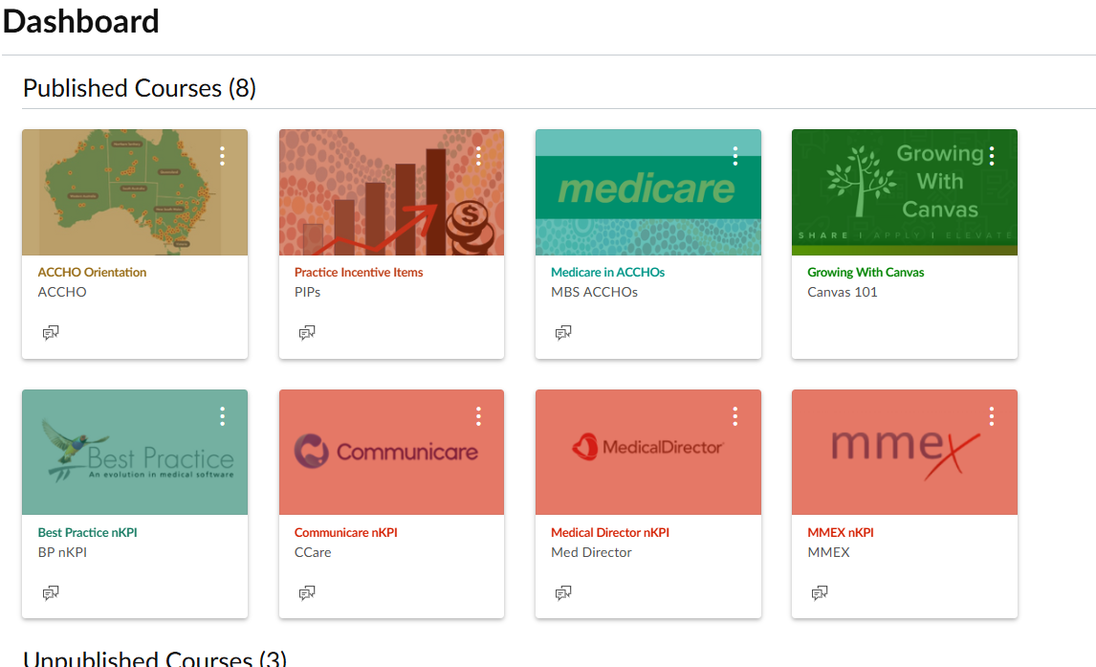
Course 1 - MBS
Understanding the main item numbers billed in ACCHO
How to use them/ Interpretation
Who is responsible
Case Studies
Incentive Programs

Slide 14
Course 2 -PIP
Incentives
  Practice
  Workforce
  Indigenous Health
Plan Do Study Act

Slide 15
Course 3 - nKPI
Clinical Software
  Best Practice
  Medical Director
  Communicare
  MMEX
Visual Demonstration
Notes:
Link to current nKPIs

Slide 16
Course 4 – ACCHO Orientation
Overview
Government Policy
Roles & Responsibilities
Recap on Medicare
Partnerships & Collaborations
Module 5: Introduction: ACCHO Orientation

Slide 17
Course 1 - MBS
Understanding the main item numbers billed in ACCHO
Case Studies
Incentive Programs
Notes:
KIM Looking at the clinic care plan, MBS module 3 slide 3 and 4 (ways to improve billing)
Case studies
Talk about incentives

Slide 18

Specific Key Item numbers
715’s
Chronic disease
Notes:
The focus is on specific item numbers – the items that are the most useful to our patients.

Slide 19
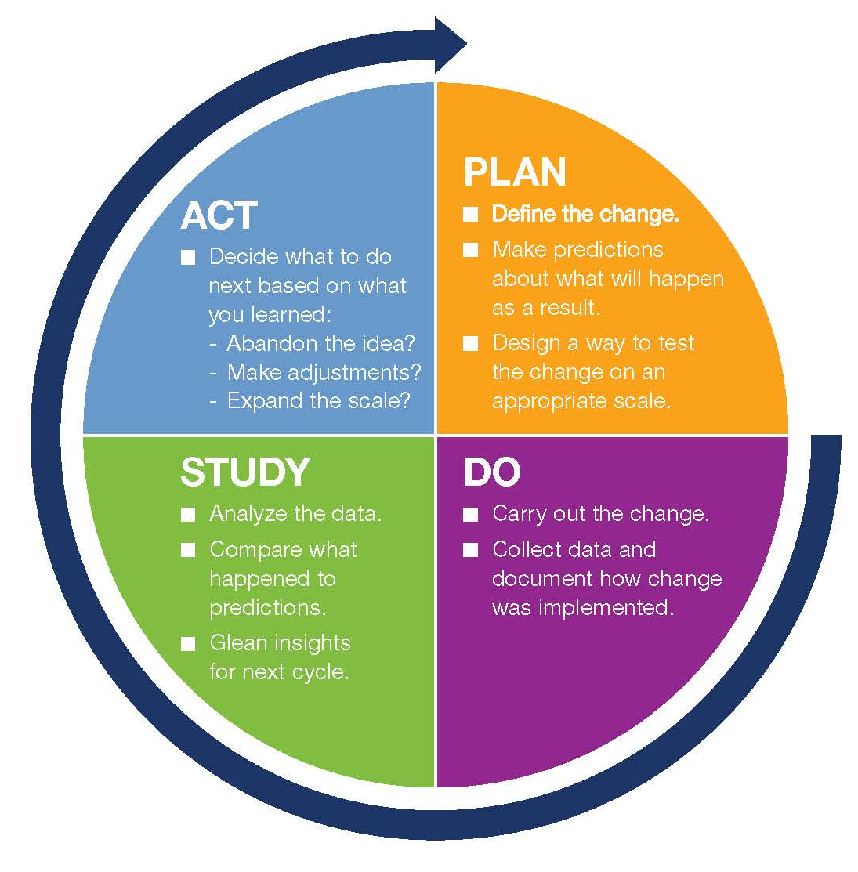
Course 2
Practice Incentive Items
(PIP)
Notes:
Kim breakdown of the PIP – looking at all the incentive items available to GP practices. This includes PIPs and WIP (workforce incentive payments)
IHI – main incentive for ACCHOs
eHealth
After Hours
Quality Improvement
Teaching payments
Procedural activities
Rural loading

Slide 20
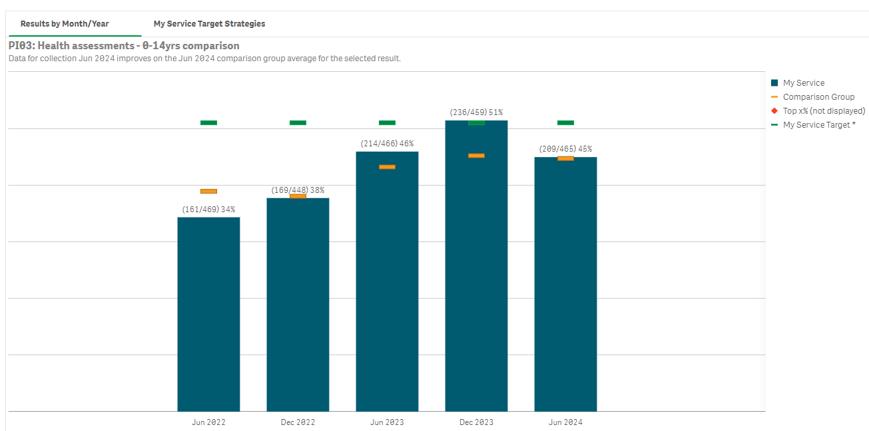
Health Assessments 0- 14years
Notes:
PDSA – look at your data, how well are you doing what can you do better, how

Slide 21
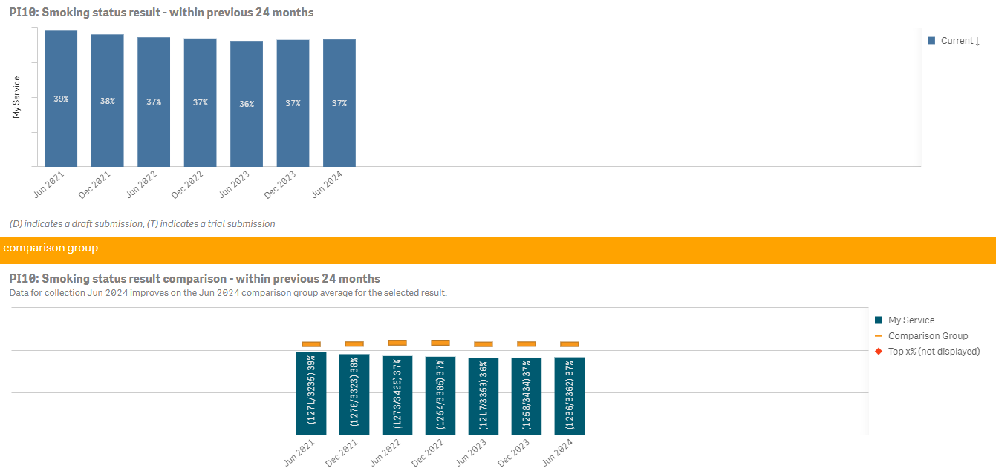
Comparison group is QLD, all age groups, current smoker
Notes:
Compare your data – use the programs available to you to examine your data. Data portal, penCAT

Slide 22
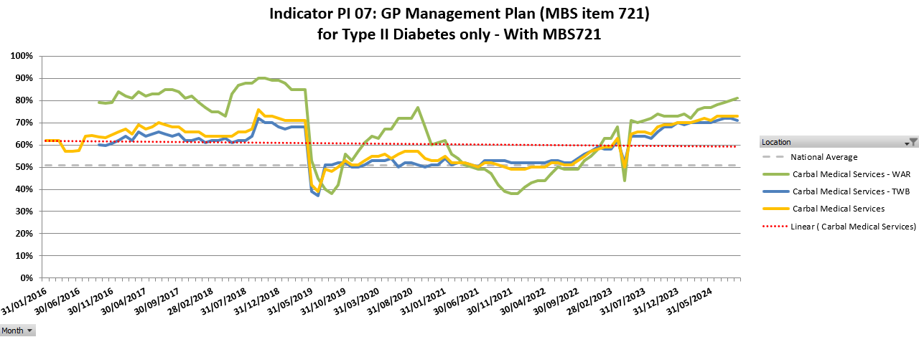
Notes:
Create your own graphs, use data collection tools

Slide 23
Course 3 - nKPI
Data Entry = $$$$
Notes:
Kim – nKPI overview, how the process is completed.
Relates to PIP payments

Slide 24
Course 4 – ACCHO Orientation
Module 5: Introduction: ACCHO Orientation
Recap on Medicare
Dr Liz
AHW - Elly
Notes:
Links – helping staff to understand the differences.

Slide 25

WHAT IS IT?
New Chronic Condition Management items also leverage MyMedicare and are likely to drive a wave of MyMedicare registrations by patients.
To support continuity of care, patients registered through MyMedicare are only able to access GP chronic condition management plan and review items through the practice where they are registered for MyMedicare
(patients not registered for MyMedicare will be able to access the items through their usual GP).

Slide 26


My Medicare: Video
MyMedicare explainer video for health workers – First Nations | Australian Government Department of Health and Aged Care

Slide 27

Changes from 1 July 2025 (this is happening)
GP Management Plan/
TCA
Chronic Condition
Management Plan (GPCCMP)
Aside from the change in name to Chronic Condition Management, existing items will cease from 1 July 2025 including:
GP management plans (229, 721, 92024, 92055),
Team care arrangements (230, 723, 92025, 92056), and
Reviews (233, 732, 920278, 92059)
These items will be replaced with streamlined GP chronic condition management plans and reviews

Slide 28
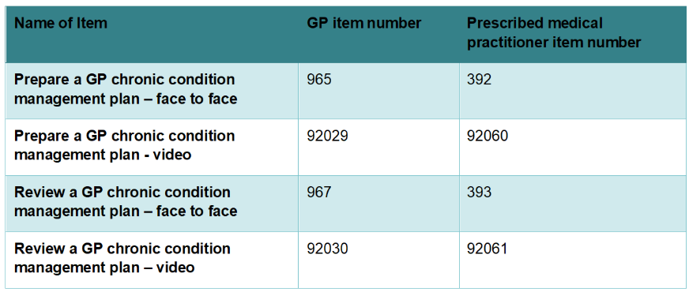
GP Chronic Condition Management Items commencing 1 July 2025

Slide 29
Changes from 1 July 2025
These new item numbers are also anticipated to outline the important role of practice nurses, Aboriginal health workers and Aboriginal and Torres Strait Islander health practitioners in assisting GPs in the preparation of chronic conditions management plans and reviews.
To encourage more regular reviews and ongoing care, the MBS fees for planning and review items will be equalised.
Patients will also need to have their GP chronic condition management plan prepared or reviewed in the previous 18 months to access related allied health services.
Currently 2.6M Australians are registered for MyMedicare. (March 25)

Slide 30
What are the changes ?
The updated framework will be known as chronic condition management.
Available to patients with at least one medical condition that has been (or is likely to be) present for at least 6 months, or is terminal.
To support continuity of care
The plans are intended to support patients
Patients will be eligible if managed by their GP, whether or not multidisciplinary care is required.
Where multidisciplinary care is required
GPs will refer patients to allied health services directly. The requirement to consult with at least two collaborating providers, will be removed.
Practice nurses, Aboriginal and Torres Strait Islander health practitioners and Aboriginal health workers can assist the GP
Notes:
The GP chronic condition management plan will be available to patients with at least one medical condition that has been (or is likely to be) present for at least 6 months, or is terminal.
To support continuity of care, patients registered through MyMedicare will be required to access the GP chronic condition management plan and review items through the practice where they are registered. Other patients will be able to access the items through their usual GP.
The plans are intended to support patients that would benefit from a structured approach to their care.
Patients will be eligible for the plan if their condition is managed by their GP or prescribed medical practitioner, whether or not multidisciplinary care is required.
Where multidisciplinary care is required, patients will be able to access the same range of services currently available through GP management plans and team care arrangements.
GPs and prescribed medical practitioners will refer patients with a GP chronic condition management plan to allied health services directly. The requirement to consult with at least two collaborating providers, as described under the current team care arrangements will be removed.
Practice nurses, Aboriginal and Torres Strait Islander health practitioners and Aboriginal health workers will be able to assist the GP or prescribed medical practitioner to prepare or review a GP chronic condition management plan.

Slide 31
When can the plan be completed ?
a GPCCMP can be prepared once every 12 months (if necessary) and
Reviews can be conducted once every 3 months.
It is not required that a new plan be prepared every year, the existing plan can continue to be reviewed.

Slide 32
Referrals
No form required for Allied Health – this is now a letter
Current plans completed before 1 July can continue to be used for 2 years
From 1 July 2027 this new process will be required for continued services.
From 1 July 2027 patients will require a GPCCMP to access Medication reviews ( items 245 & 900)

Slide 33
What can patients access?
Up to 5 individual allied health services per calendar year (10 services for patients of Aboriginal or Torres Strait Islander descent).
Up to 5 services by a practice nurse or Aboriginal and Torres Strait Islander Health Practitioner.
For patients with type 2 diabetes, an assessment of their suitability for group dietetics, diabetes education or exercise physiology services and, if they are suitable, up to 8 group services for the management of diabetes per calendar year.

Slide 34
Fees
Both items – GPCCMP and Review $156.55 each ($125.30 pmps)
GPCCMP – claimed every 12 months if clinically relevant
Reviews – claimed every 3 months
While GPCCMPs do not expire, patients must have had a GPCCMP prepared or reviewed in the previous 18 months to continue to access allied health and other services under the plan.
Notes:
Prescribed medical practitioners

Slide 35
Access through MyMedicare
Patients registered with MyMedicare must access GPCCMP items through the practice where they are enrolled; patients that are not registered may access the services through their usual GP.

Slide 36
Statistics
Almost 1 in 6 (16%; 4.1 million) Australians claimed a Chronic Disease Management service
More than 35% of Aboriginal and Torres Strait Islander adults live with cardiovascular disease, diabetes, or chronic kidney disease. (reported in 2024).
In 2018, the burden of disease among Aboriginal and Torres Strait Islander (First Nations) people was 2.3 times that of non-Indigenous Australians.
60% of people (10.2 million) who visited a general practitioner (GP) in the last 12 months had a long-term health condition.

Slide 37
Advocating ACTION for readiness
Ensure all ACCHOs are registered for MyMedicare and aware of the changes
Encourage ACCHO team meetings;
  What do these changes mean, who will answer questions, who will monitor sign ups, how will they educate mob
  Identify any activities or processes need to complete; incorporating MyMedicare registration for reception
Make use of resources that have been provided by Medicare

Slide 38
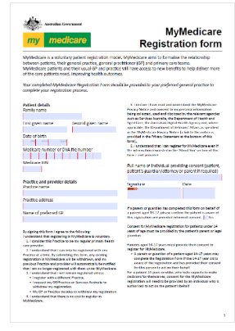
ACTION for readiness –
Mob to sign up
ACCHOS to engage mob to encourage them to register with MyMedicare, particularly those with a chronic condition or existing care plan:
  Extract records of those who have a current chronic disease
  Include the MyMedicare Registration form

Slide 39

ACTION for readiness –
Create awareness
Print brochures and Posters for waiting rooms

Slide 40
Advocating ACTION for readiness –
Update websites
  Include links to:
  MyMedicare brochures
  MyMedicare patient registration information,
  MyMedicare patient registration frequently asked

Slide 41
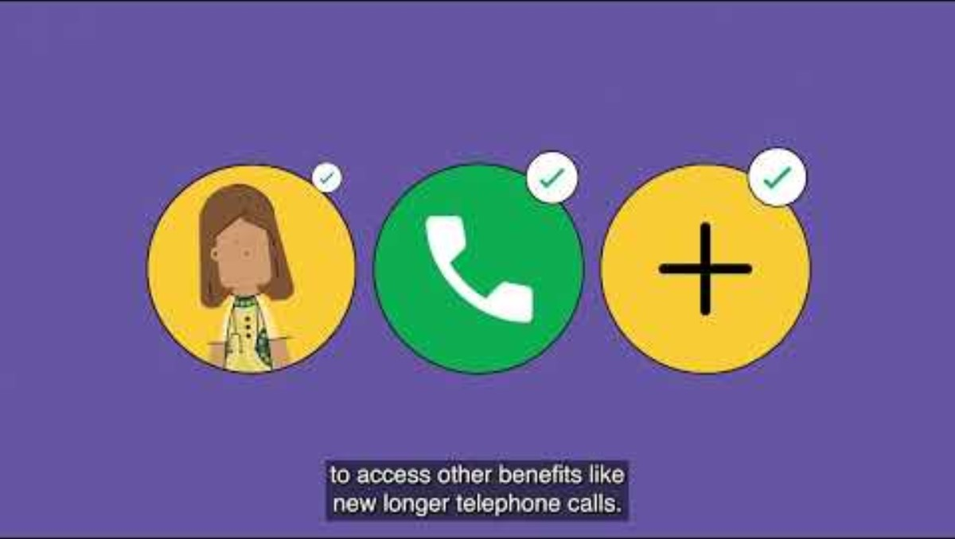
Advocating ACTION for readiness –
Social Media

Slide 42

Final Questions/
Challenges

Slide 43
NACCHO - Support
Contact
Access Licensing
Help with Canvas
Gaps identified

Slide 44
Thank you
Kim Passante
Project Lead
MBS National Coordinator
NACCHO
Notes:
Introduction

