Slide 1

Using The Six Thinking Hats
A way to explore an opportunity or problem from multiple perspectives.
Kerry Copley
kjcopley@outlook.com

Slide 2

“I acknowledge the traditional custodians of the land on which we are meeting today, the the Gadigal of the Eora Nation, and pay my respects to their Elders past, present and emerging.”

Slide 3


Slide 4

CQI is about
“How can we do this better???”

Slide 5
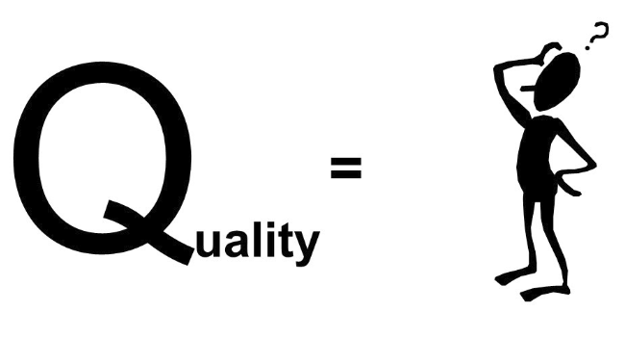

What does Quality look like to you?
Activity 1

Slide 6

Effective quality improvement needs all the essential components or cogs working together.

Slide 7
Review and modify the ‘action plan’
The CQI Process
Look at the data
Gather resources
& implement ‘action plan’
Discuss possible cause/solutions
Planning
A Team Approach
Come up with an ‘action plan’
Explore various ideas

Slide 8
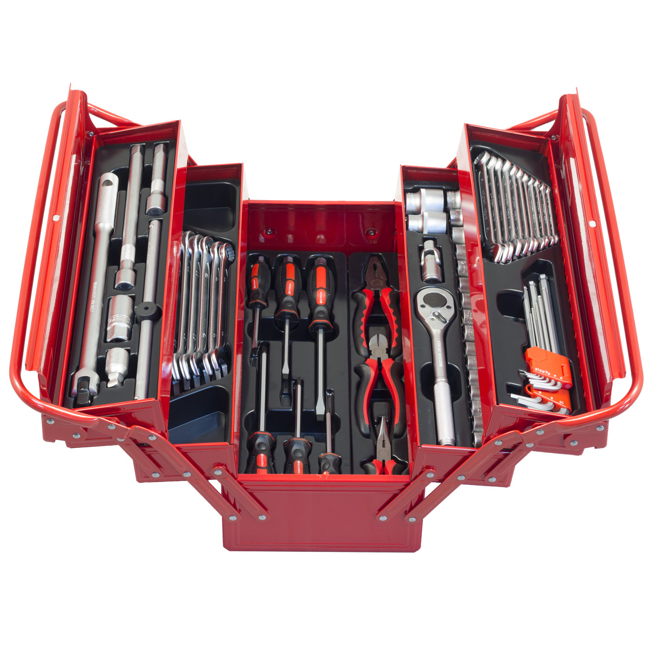
Let's add another tool to your own toolbox.

Slide 9
The Six Thinking Hats
Developed by Edward de Bono and has been used across healthcare, education and commercial industries.

Slide 10
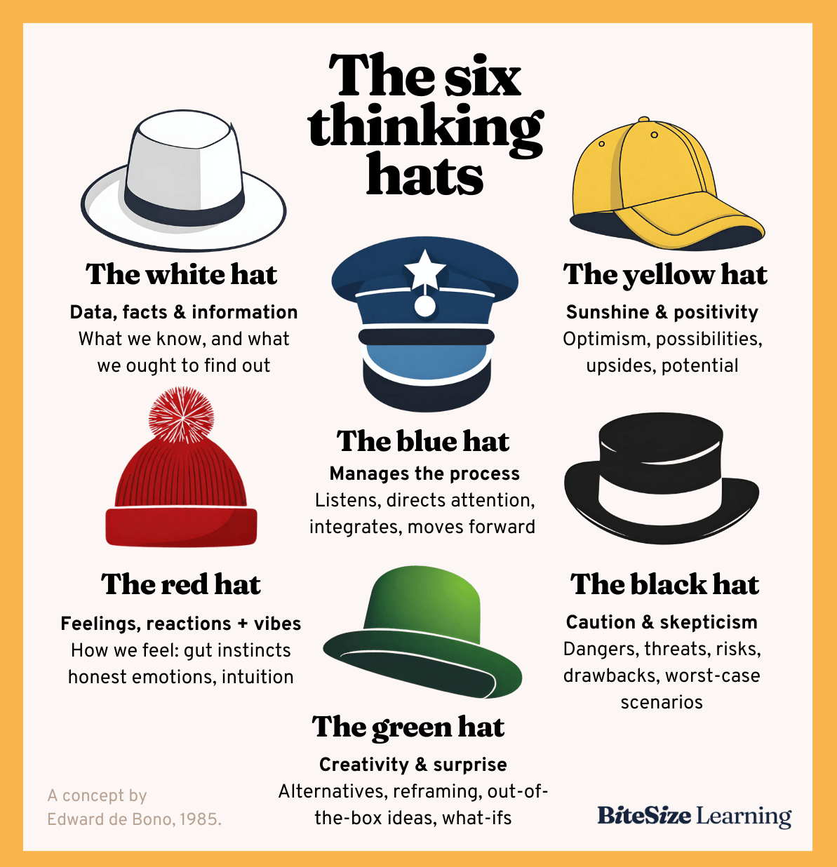

The Six Thinking Hats

Slide 11
The Six Thinking Hats
A way to explore an opportunity or problem from multiple perspectives.

Slide 12
The 6 Thinking Hats
The 6 Thinking Hats is a technique for a structured group discussion around a problem or opportunity.
Each of the “6 Hats” is a different colour to remind us of the different type of thinking involved.
The members of the group switch hats to explore different perspectives that lead to a more comprehensive decision-making process.

Slide 13
The 6 Thinking Hats
You can transform you decision-making processes, empowering your team to think creatively, critically and collaboratively, leading to improved results.
It can help to reduce bias, enhance creativity, balance emotion and logic, and identify risks and benefits.

Slide 14

Why use Six thinking hats?
Six thinking hats
Helps us consider a situation from different perspectives
Helps us move outside habitual ways of thinking
Reduces conflict
Reveals opportunities
Encourages creativity
Facts

Slide 15


White Hat – Facts
What do we know?
What do we need to find out?
Just the facts!
Facts NOT opinions

Slide 16

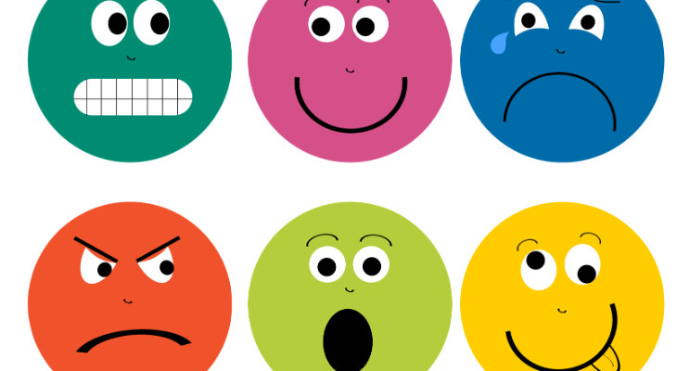
Red Hat - Emotions
Feelings
Hunches
Share feelings, fears, likes, dislikes, loves and hates
No reasons necessary

Slide 17


Black Hat – Negative Logic
What could go wrong?
What are the risks/problems?
Where are the mistakes?

Slide 18



Yellow Hat – Positive Thinking
Positives
Look for the good things
Benefits
Opportunities
Vision

Slide 19


Green Hat - Creativity
Explore ideas
Look for alternatives
Get creative
Outside the box thinking

Slide 20


Blue Hat – Control
Where are we now?
Where have we been?
What is the next step?
Is in charge

Slide 21
Let’s do it!!

Slide 22
Let’s do it!!
We want to improve our Medicare claiming & revenue
Activity 2
Notes:
Mbs digital health theme – upcoming changes
Struggling with medicare – improve medicare claiming /revenue
Digital health – cyber security big issue

Slide 23

Six Thinking Hats
Group Exercise
The money story – more $$$ we can use
Get the team involved
Improve systems and processes
  IT systems & patient flow systems
Educated and informed workforce
Identify the holes in our systems
Follow up rejected claims

Slide 24
How?
I will facilitate the process from the front
We will use each of the different hats – White, Red, Yellow, Green and Black to look at our topic from different perspectives
Each table appoints a “Blue Hat” person to lead the discussion at the table
Someone to document the ideas under each coloured hat

Slide 25
White Hat – Facts
What do we know?
What do we need to find out?
Just the facts!
Facts NOT opinions

Slide 26
Red Hat - Emotions
Feelings
Hunches
Share feelings, fears, likes, dislikes, loves and hates
No reasons necessary

Slide 27
Black Hat – Negative Logic
What could go wrong?
What are the risks/problems?
Where are the mistakes?

Slide 28
Yellow Hat – Positive Thinking
Positives
Look for the good things
Benefits
Opportunities
Vision

Slide 29
Green Hat - Creativity
Explore ideas
Look for alternatives
Get creative
Outside the box thinking

Slide 30
Blue Hat – Control
Where are we now?
Where have we been?
What is the next step?
Is in charge

Slide 31
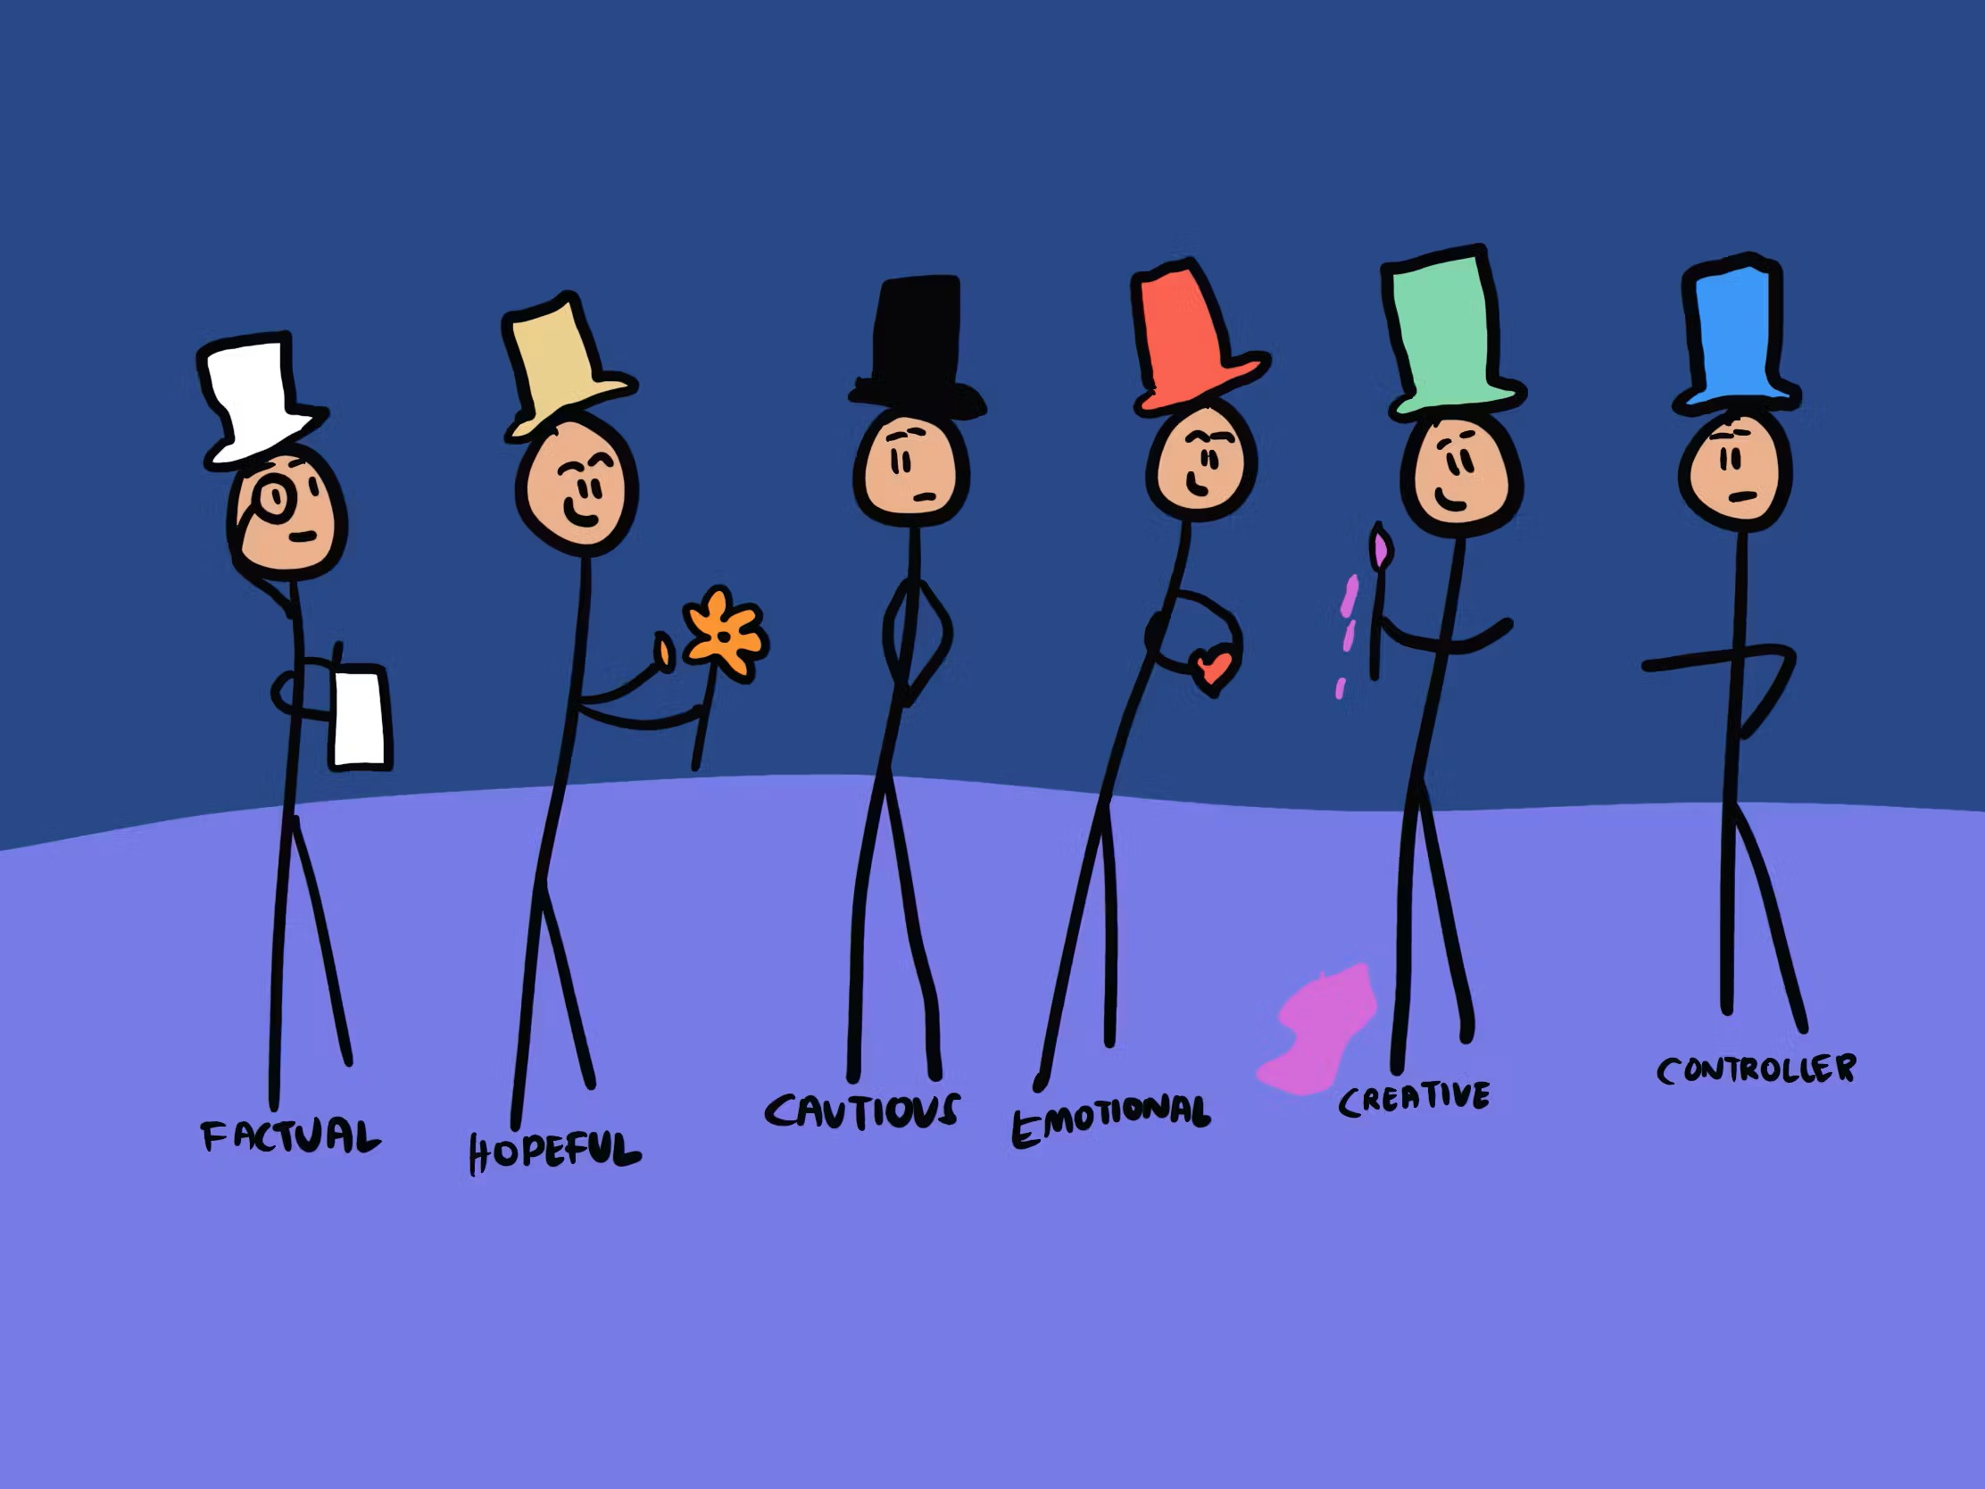
Feedback

Slide 32
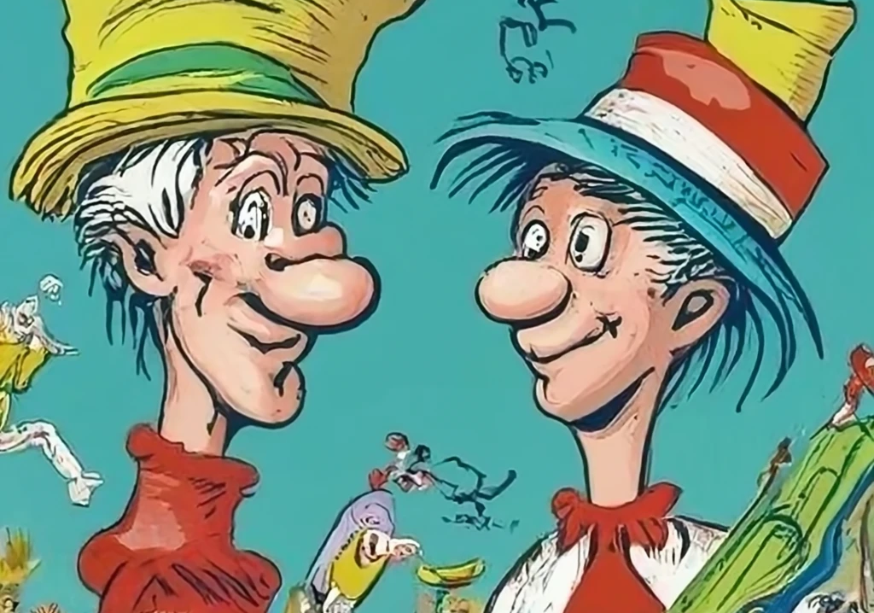
Be aware of the different hats people might be wearing….
Use the Six Thinking Hats to increase
the effectiveness of your meetings
Remember you can choose to wear a different hat!!
Think about which hat you are wearing?

Slide 33


