Slide 1
Aligning AHW & AHP Roles with Medicare Revenue Growth
Jade Hansen
Director of Recovery

Slide 2
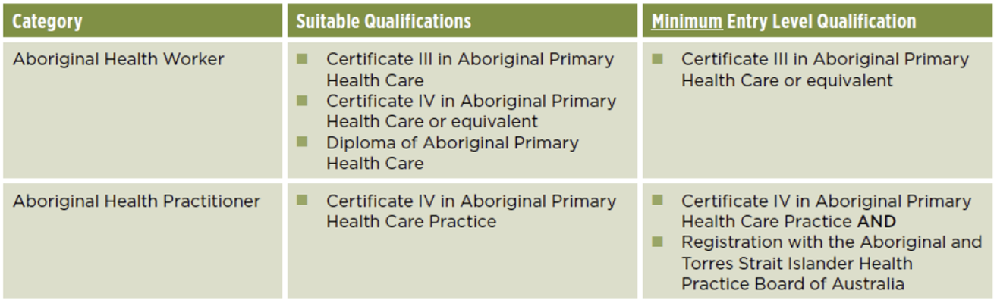

Slide 3
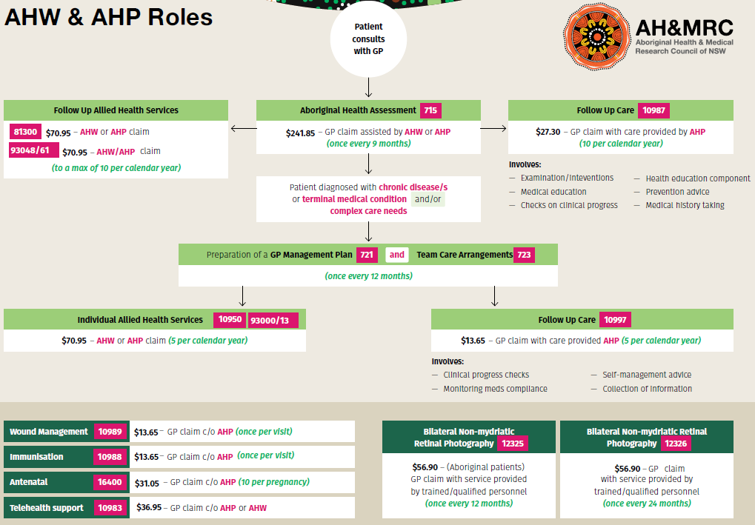

Slide 4
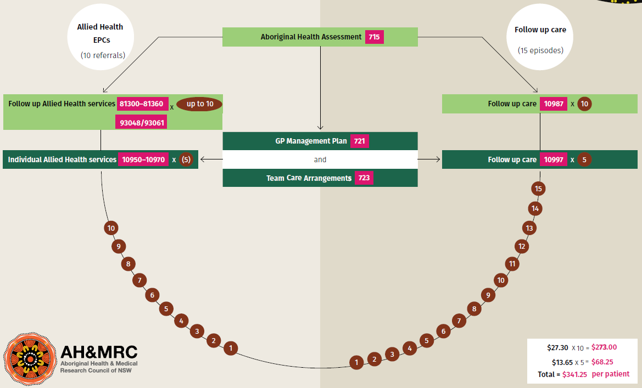
Follow up Care Items

Slide 5
Claimable MBS for AHW’s
claim using their own Medicare provider number:
10950 – Face to Face (Individual allied health service for chronic disease management) 5 PER YEAR
93000 – Telehealth (Individual allied health service for chronic disease management) 5 PER YEAR
93013 – Phone (Individual allied health service for chronic disease management) 5 PER YEAR
81300 – Face to Face (Follow-up Allied Health Service for people of Aboriginal or Torres Strait Islander Descent) 10 PER YEAR
93048 – Telehealth (Follow-up Allied Health Service for people of Aboriginal or Torres Strait Islander Descent) 10 PER YEAR
93061 – Phone (Follow-up Allied Health Service for people of Aboriginal or Torres Strait Islander Descent) 10 PER YEAR
perform and claim on behalf of, and under the supervision of a Medical Practitioner:
10983 – Telehealth support service
13105 – Haemodialysis for end-stage renal disease in MM7 Area

Slide 6
Claimable MBS for AHP’s
claim using their own Medicare provider number:
10950 – Face to Face (Individual allied health service for chronic disease management) 5 PER YEAR
93000 – Telehealth (Individual allied health service for chronic disease management) 5 PER YEAR
93013 – Phone (Individual allied health service for chronic disease management) 5 PER YEAR
81300 – Face to Face (Follow-up Allied Health Service for people of Aboriginal or Torres Strait Islander Descent) 10 PER YEAR
93048 – Telehealth (Follow-up Allied Health Service for people of Aboriginal or Torres Strait Islander Descent) 10 PER YEAR
93061 – Phone (Follow-up Allied Health Service for people of Aboriginal or Torres Strait Islander Descent) 10 PER YEAR

Slide 7
Claimable MBS for AHP’s (Continue)
perform and claim on behalf of, and under the supervision of a Medical Practitioner:
10983 – Telehealth support service 10987 – Face to Face (Follow up service for an Indigenous person who has received a 715) 10 PER YEAR
93200 – Telehealth (Follow up service for an Indigenous person who has received a 715) 10 PER YEAR 93202 – Phone (Follow up service for an Indigenous person who has received a 715) 10 PER YEAR
10988 – Immunisation service (must meet State/territory requirements) – 1 per visit
10989 – Wound management service – 1 per visit
10997 – Face to Face (Monitoring and support for a person with chronic disease) 5 PER YEAR
93201 – Telehealth (Monitoring and support for a person with chronic disease) 5 PER YEAR
93203 – Phone (Monitoring and support for a person with chronic disease) 5 PER YEAR
13105 – Haemodialysis for end-stage renal disease in MM7 Area AS REQUIRED
16400 – Face to Face (Antenatal service in MMM 2-7) 10 PER PREGNANCY
91850 – Telehealth (Antenatal service in MMM 2-7) 10 PER PREGNANCY
91855 – Phone (Antenatal service in MMM 2-7) 10 PER PREGNANCY

Slide 8
Scenario
We completed 304 health checks and 91 GPMP/TCA from 1st July to 31st December (6 months). Of these assessments only 101 referrals using an Allied Health Referral Form (aka EPC referral form) have been completed out of a possible 3,950. This is 3,849 more services available totalling $273,086.55 that hasn’t been claimed
A total of 682 follow up services were completed (634 services from health check follow ups and 48 services from GPMP/TCA follow up on behalf of the GP) out of a possible 3,495. This is a total of $69,928.95 of self-generated funds that haven’t been claimed from not providing a comprehensive follow up service.
Total of unclaimed Medicare for the end of the calendar year is $343,015.50

Slide 9
Who should we look at, at becoming an AHW?
SEWB Workers
AOD Workers
Dental Assistants
TIS workers
Transport Drivers
Community Program Workers e.g. men’s, women’s, youth groups/programs
ITC Coordinators

Slide 10
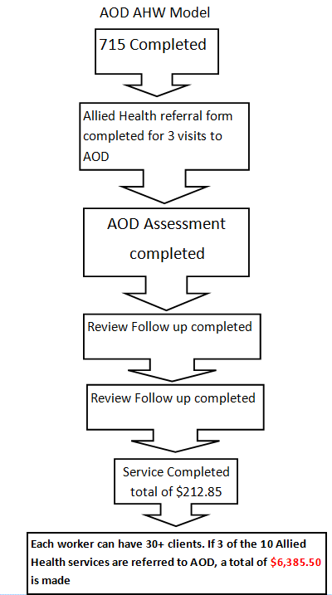


Slide 11
Questions?

Slide 12
Thank you!

