Slide 1
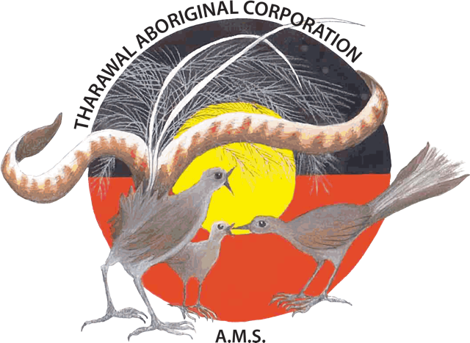
Tharawal Aboriginal Corporation
Tharawal Aboriginal Corporation (TAC) is a multifunctional Aboriginal Community Controlled Organisation incorporated in 1983 under the Aboriginal Councils & Associations Act 1975. The Community appoints its Directors to the Board every two years.
TAC provides services throughout the Greater Macarthur area and wider

Slide 2
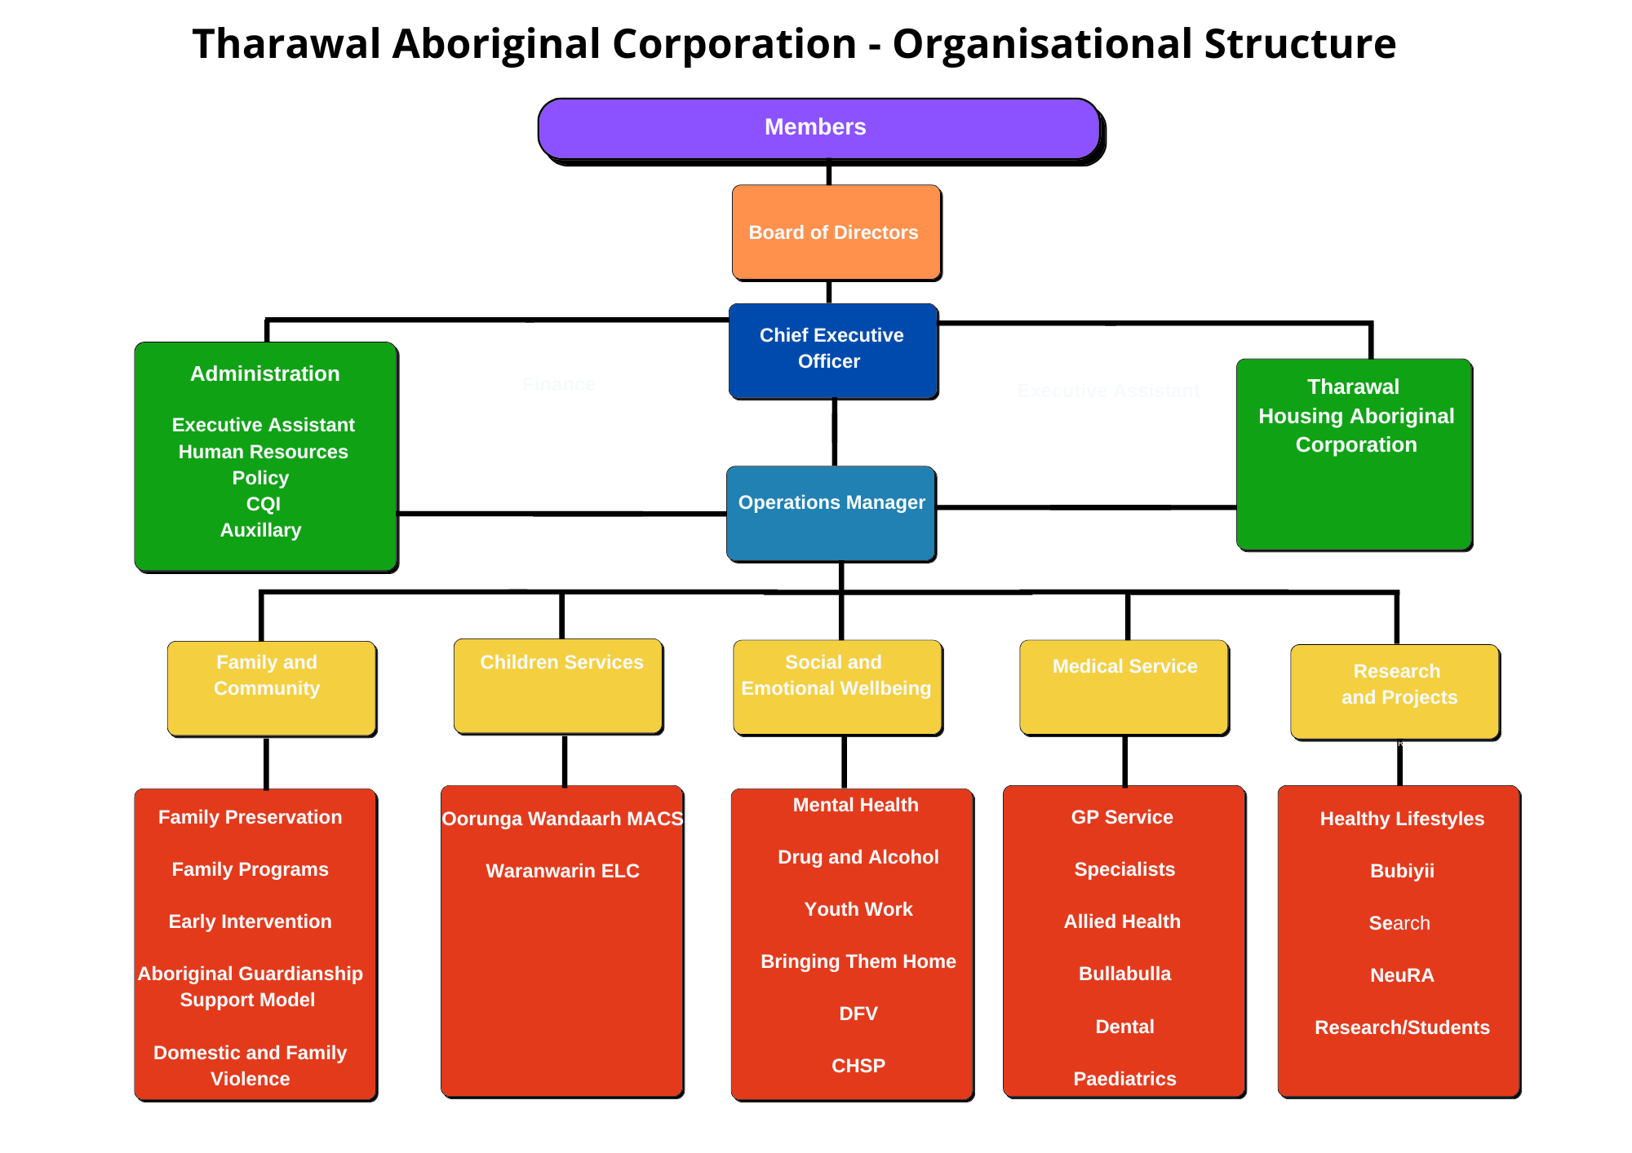

Slide 3
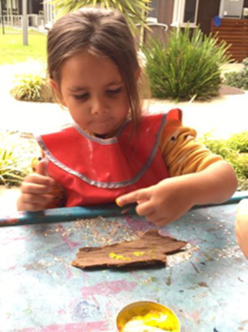
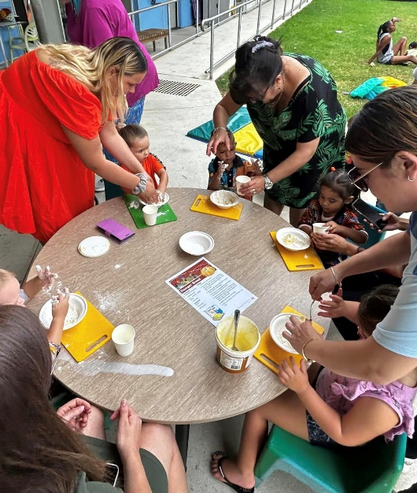
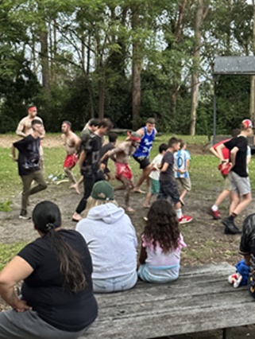
Waranwarin Tharawal Child and Family Centre
Waranwarin Tharawal Child and Family Centre consists of several programs and is funded through State and Federal Government agency. Waranwarin provides culturally safe services in a culturally safe environment. Families with Aboriginal children can access a range of coordinated services in the early years and beyond.

Slide 4
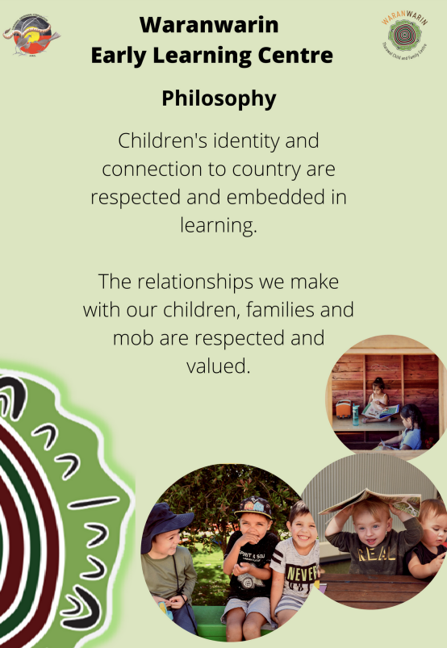
Waranwarin Early Learning Centre
Waranwarin is an Aboriginal Early Learning Centre is a 67 children per day placement centre that offers 52 place per day for children aged between 6 weeks – 5 years of age and 15 place per day for Outside of School Hours for primary school aged children.
At Waranwarin Early Learning Centre we pride ourselves on providing high quality Early Childhood Educational and Care Services. Our priority is to serve our local Aboriginal families to ensure our children have an opportunity to learn, grow and explore play in a embedding Aboriginal Learning perspectives promoting strength, pride and identity.

Slide 5
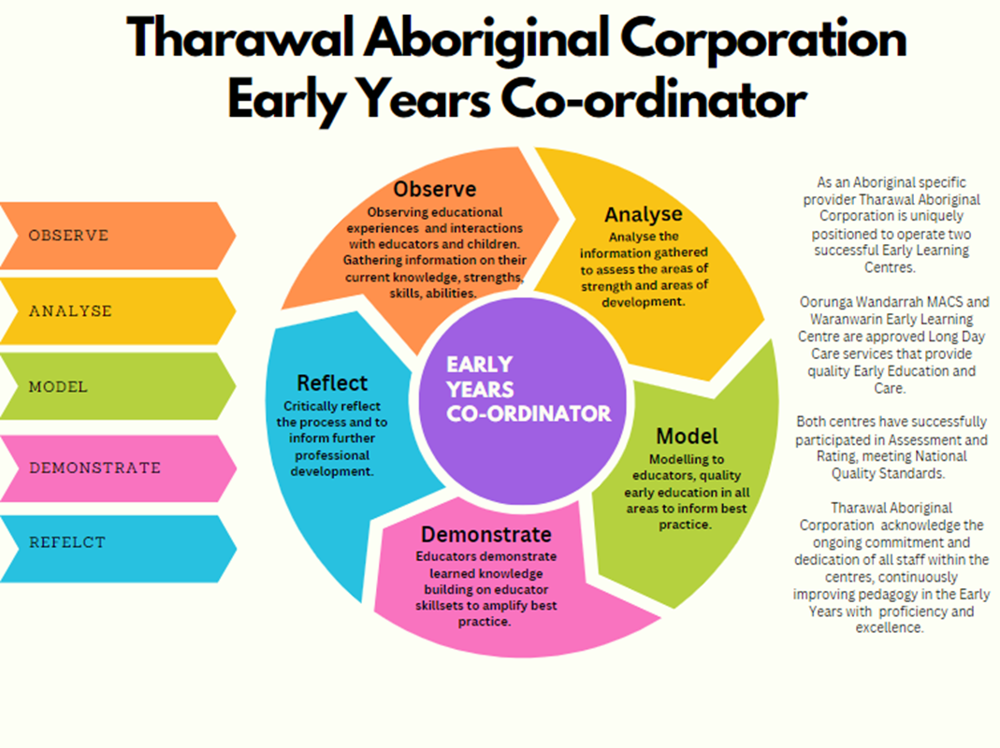

Slide 6
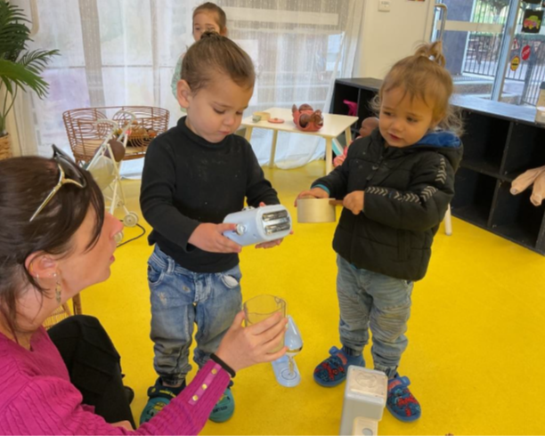
Early Learning Centre Health Initiatives
Waranwarin Tharawal Child and Family Centre have a strong partnership with South Western Local Health District, the district provided the following support.
Our educational program is complimented with the input from Allied Health Professionals. The Allied Health Professionals. They provide strategies to implement into the room and educators expand on this improving children’s developmental growth.
Staff are trained in the Aboriginal Got It, this is a program that works with children, families and educators build knowledge and strategies for managing some behaviours, including self regulation and social and emotional well being.
Our Child Family Health Nurse provides clinics to families with Aboriginal children where we just need to check who the individual children may be travelling in regards to developmental miles.
ASQ Traks – Staff trained across the organisation as practitioners
Paediatrician Clinics available if families have further queries regarding their children’s needs and assessments

Slide 7
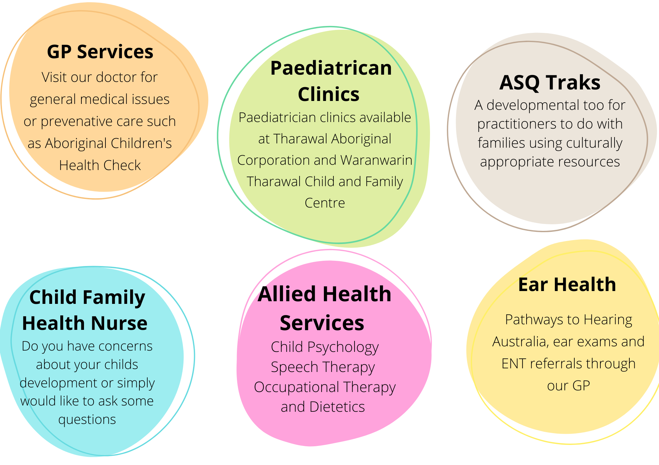
Family Health Connector Services

Slide 8
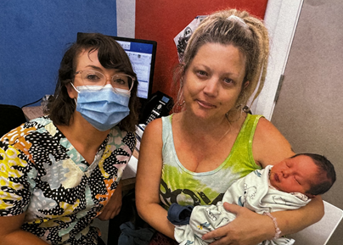

Slide 9
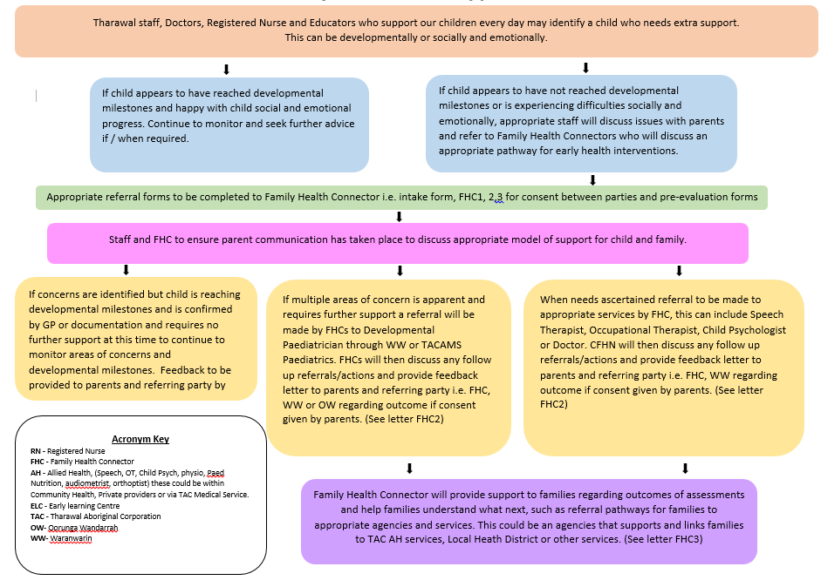
Family Health Connector Services

Slide 10
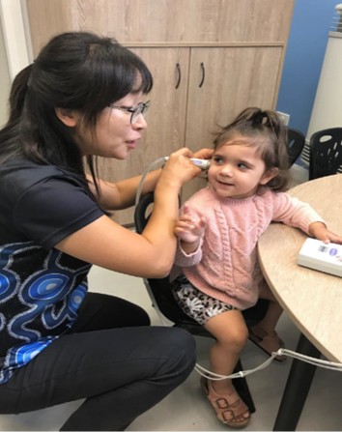
Ear Health
Through Hearing Australia Tharawal’s Early Learning spaces are supported by programs including HAPEE and Plums and Hats.
HAPEE focus on visits Waranwarin ELC, Oorungah Wandarrrah and our playgroups 4 terms per year providing diagnostic hearing assessments in the early years.
Family Health Connectors completing ear training and being able to use audiology equipment such as an tympanometers.
Variety of staff trained in Plums and Hats across both centres and can refer straight in to hearing Australia
Referrals pathways ENT specialist through Tharawal

Slide 11
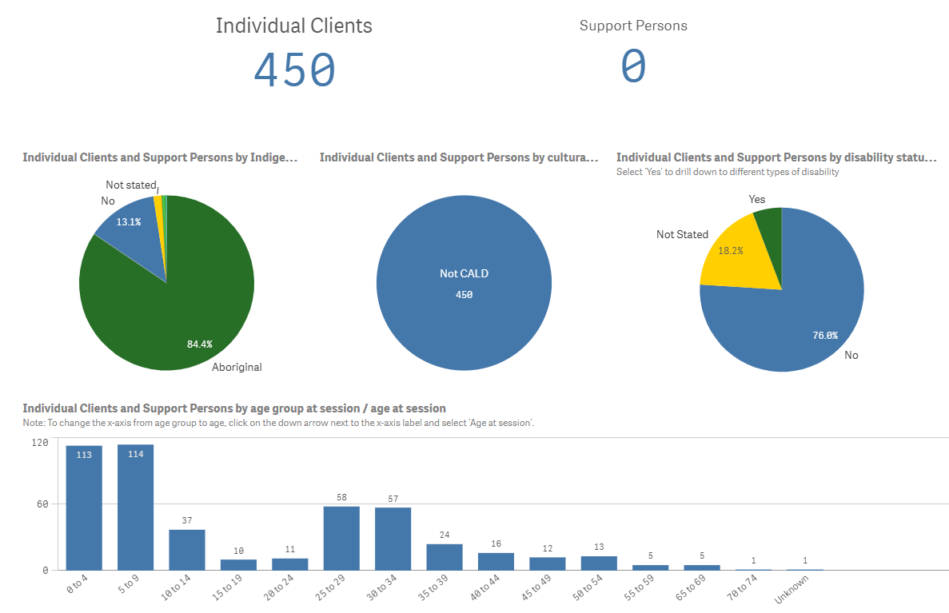
Data 23-24

Slide 12
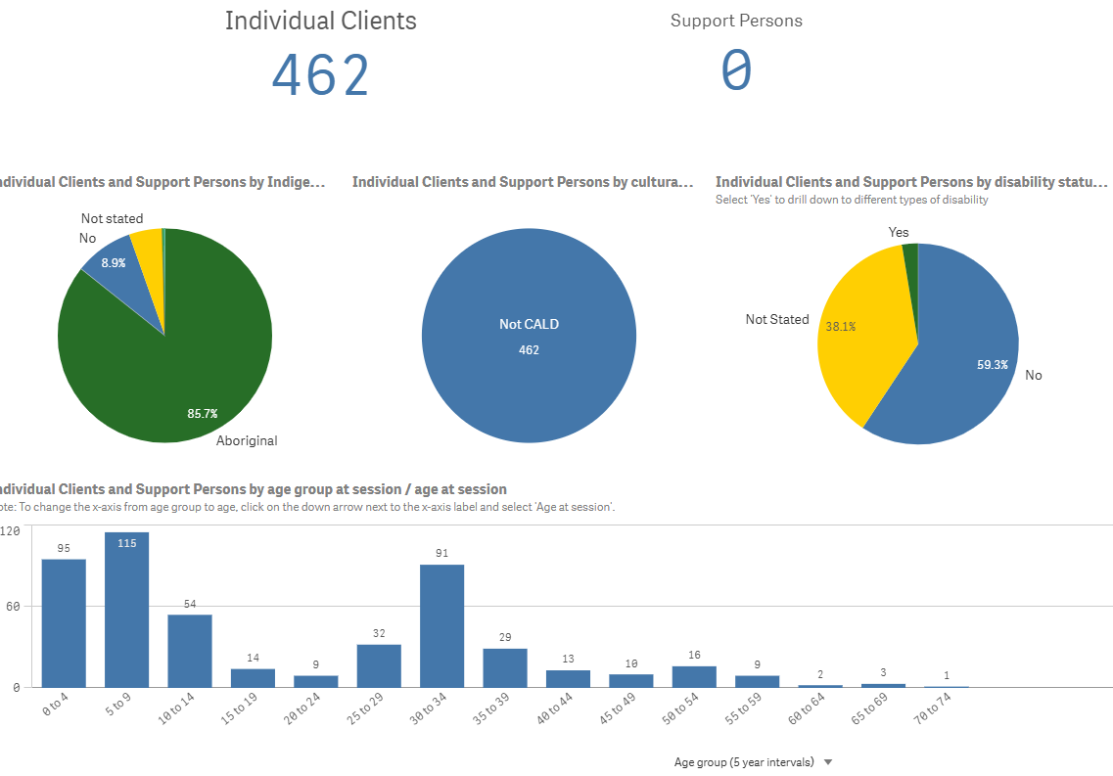
Data 24-Current

Slide 13
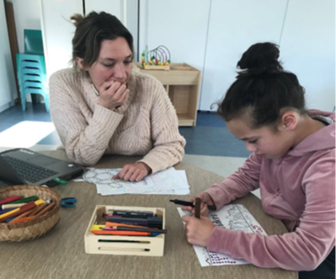

Slide 14
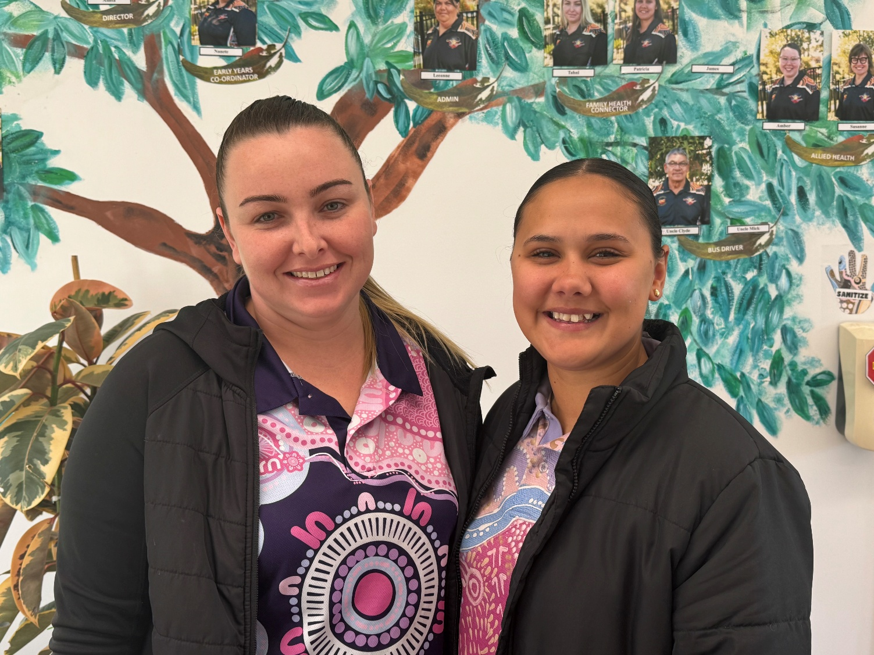
Family Health Connector
Culturally safe setting
Focus on Early Years
We capture children 5 -12
Platforms and Partnership
Opportunities to implement CQI
Growing our own
Organisation setting the scene for practitioners
https://www.health.nsw.gov.au/awards/2024/Pages/culture-leading-the-way.aspx

