Slide 1





Digital Healthcare at OAMS

Slide 2

ACKNOWLEDGEMENT
Of country
Spirit of inquiry
Spirit of courage
Spirit of resilience

Slide 3


Ms Maddie Kare’s predicament
…..possibly a true story
Sourced from virtual assistant Roberta at Virtual Health Clinic

Slide 4
One fine day, Roberta was about to grab a byte when the phone rang…
Hello. You have reached Virtual Health Clinic. I am your virtual assistant Roberta
Maddie Kare here. I’ve lost my script and need a new one.

Slide 5
Before one even had time to say “USB”, Roberta had pulled up information on Ms Maddie Kare…
Oh yes, Ms Maddie Kare, I have your health Identifier number. You are registered for Close The Gap. Do you have an Active Script List? Would you like an electronic prescription sent via SMS or email?

Slide 6
Silence.
Umm..
all of the above.
Then….

Slide 7
At this point, Roberta rolls her eyes in a vertical plane and lets out a mechanical sigh that sounds almost human.
ALMOST.
Which medication do you need, Ms Maddie Kare?

Slide 8
The white tablet, slightly square, slightly round and tastes disgusting.
YUCK

Slide 9
At this point, Roberta rolls her eyes again but in a horizontal plane and lets out 2 mechanical sighs that sounD almost human.
ALMOST.
Is the medication listed on your My Health Record, Ms Maddie Kare?

Slide 10
Ms Maddie Kare looks through her records and confidently informs Roberta ...
It is not

Slide 11

Maddie kare ponders the situation and lets out a groan that is definitely human.
DEFINITELY
Why would anyone write their medications on their records? Duh.

Slide 12
Ms Maddie Kare’s predicament
…..possibly a true story
The End
Sourced from virtual assistant Roberta at Virtual Health Clinics

Slide 13

Hurdles in the digital age
App-ful
Human-less
Changing technology
Lingo

Slide 14
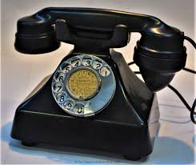
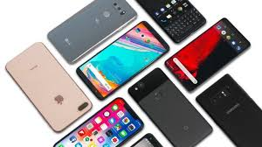
Changing technology

Slide 15
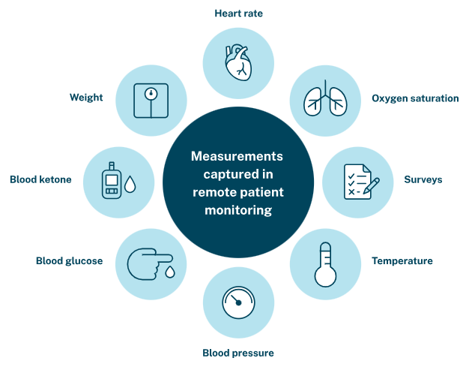
Remote monitoring

Slide 16

The confusing lingo thingo
ASL ….. Active Script List
Age , Sex, Location
Account Spending Limit
Above Sea Level

Slide 17

Robotic surgery, Microbots, Diagnostic robots
Support and Service Robots, Disinfection Robots
Social Support
Rehabilitation Robots
Human-less
Artificial Intelligence
Telepresence

Slide 18
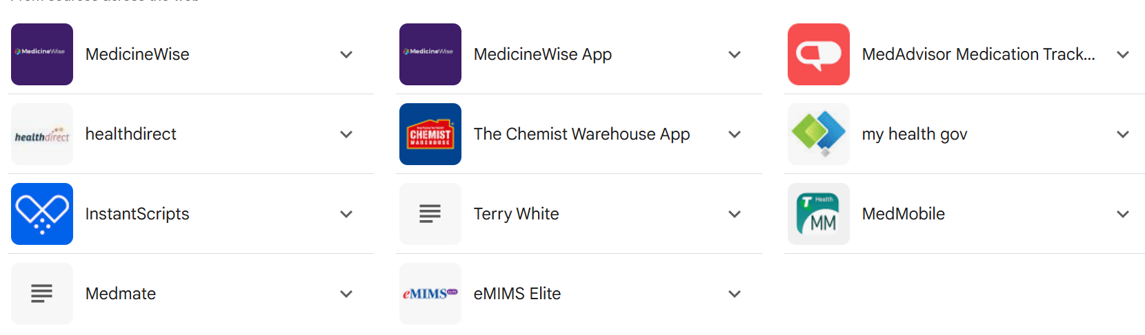
APP-FUL

Slide 19

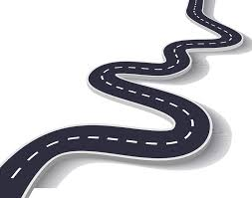
Back to basics…
Where are we on the roadmap?

Slide 20

Reaching the mob
What do you want to know?
What you need to know?
How do you want us to tell you?

Slide 21


DIGITAL healthcare tools
My Health Record
My Health App
Electronic Scripts
Telehealth consultations

Slide 22
Reaching the mob
Small group
One on one
Social media
En masse (Digital Inclusion Week)

Slide 23

Operation Piggy Back

Slide 24
Cosy gatherings at OAMS
Waluwin exercise groups
AOD groups
Elders morning teas
Healthy connections groups
Mums and Bubs groups
Men’s groups

Slide 25
The troops
CQI team
Aboriginal Health Practitioner
Aboriginal Health Practitioner trainees

Slide 26
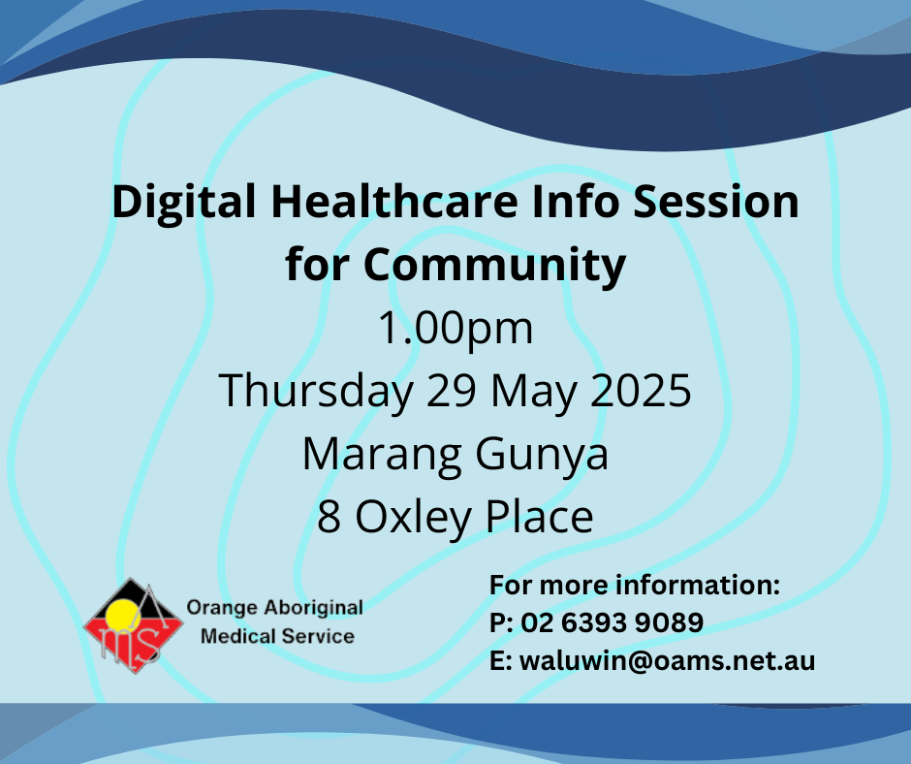

Slide 27
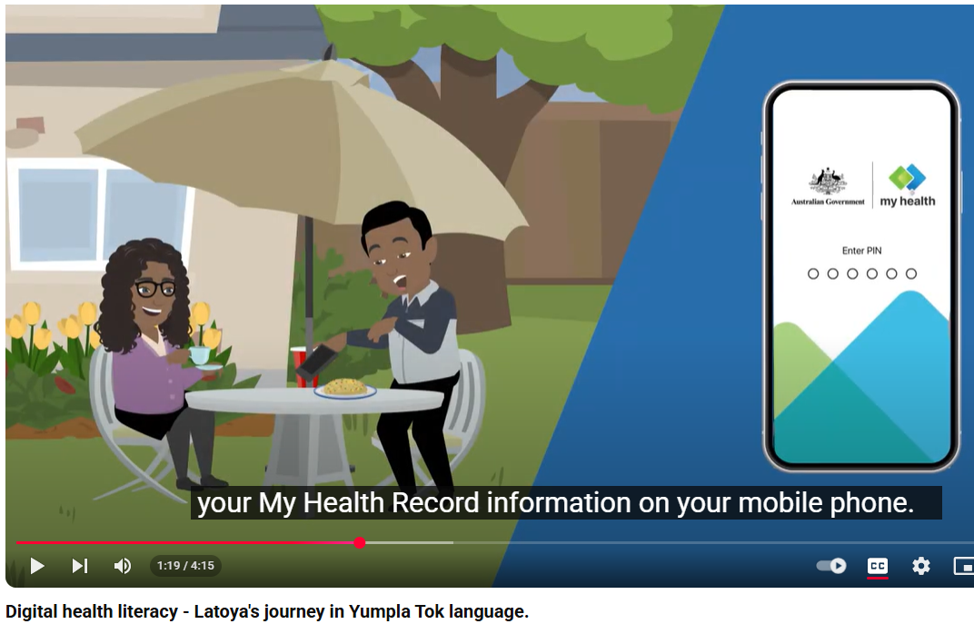
Latoya speaks English when she visits OAMS

Slide 28
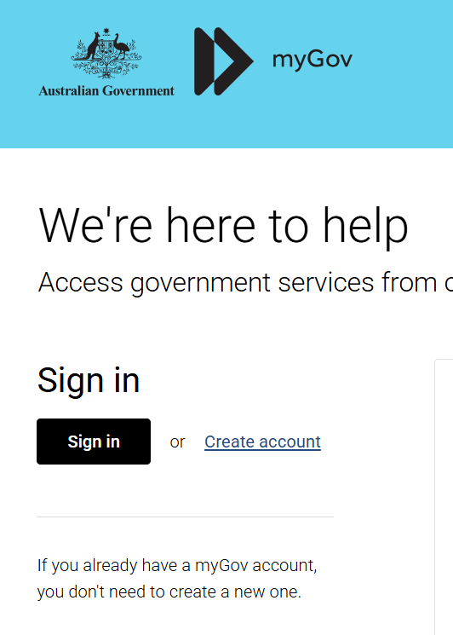
Create MyGov Account

Slide 29
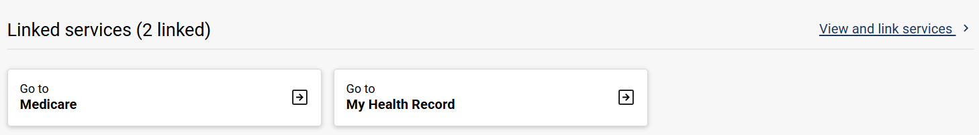
Link to My Health Record

Slide 30
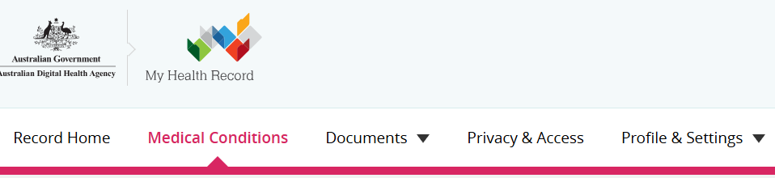
Medical conditions
Procedures in the last 2 year
Latest shared health summary
Latest event summary
Medications
Allergies and adverse drug reactions

Slide 31


Slide 32
Small Group
One on one
More relevancy

Slide 33

Coming to an OAMS near you in OCTOBER 2025!

Slide 34


Slide 35

Much gratitude to Nisha ….

Slide 36
Patients are concerned about privacy and confidentiality of MHR and are therefore reluctant to consent

Slide 37
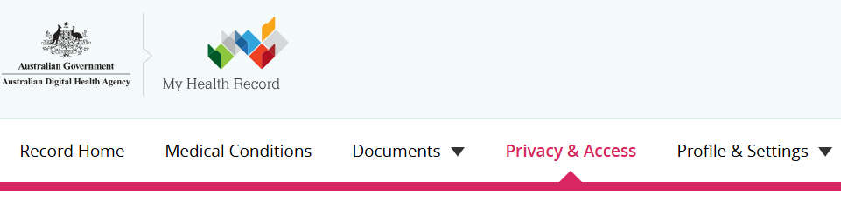
WHO CAN SEE
My representatives
Family, friends, carers
My healthcare organisations
Medical practices, hospitals
HOW MUCH
General access
–can view all documents except those marked restricted
Restricted access – all documents including restricted
Full access –can view all documents and add to record

Slide 38
feeling a bit lost on how to educate patients about MHR
ASK

Slide 39
Some hospitals still do not upload shared health summaries
Get hospital doctors to walk in GP shoes for a day
One summary is better than none

Slide 40
MHR is primarily used by GPs to view discharge summaries
Get GPs to walk in hospital doctor shoes for a day
Hospital doctors need to know background medical history
MHR is a means of communication across the board… GP, specialists, hospital, pharmacists, patient
GPs need to be actively updating the health summaries

Slide 41
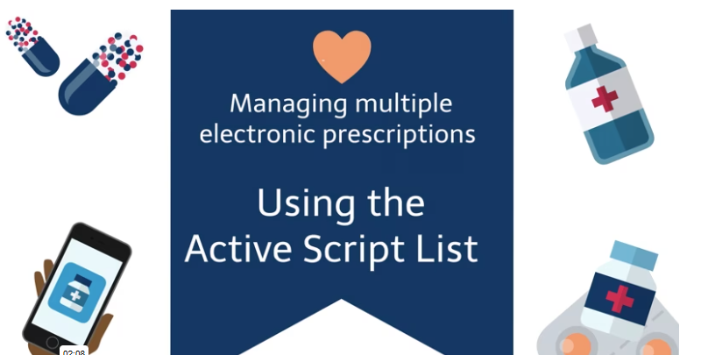
Concerns about e-scripts and if they are easy to use especially by the elderly
Multiple medications
No need to keep paper scripts or tokens
Can nominate a representative
Home deliveries
!
Ideal for the elderly

Slide 42

KNOWLEDGE

Slide 43

POWER

Slide 44

PILOT

Slide 45

Change is inevitable
Anxiety is understandable
Integration is possible
Progress is achievable

Slide 46
Spirit of inquiry
Spirit of courage
Spirit of resilience

Slide 47
Mandaang Guwu

