Slide 1


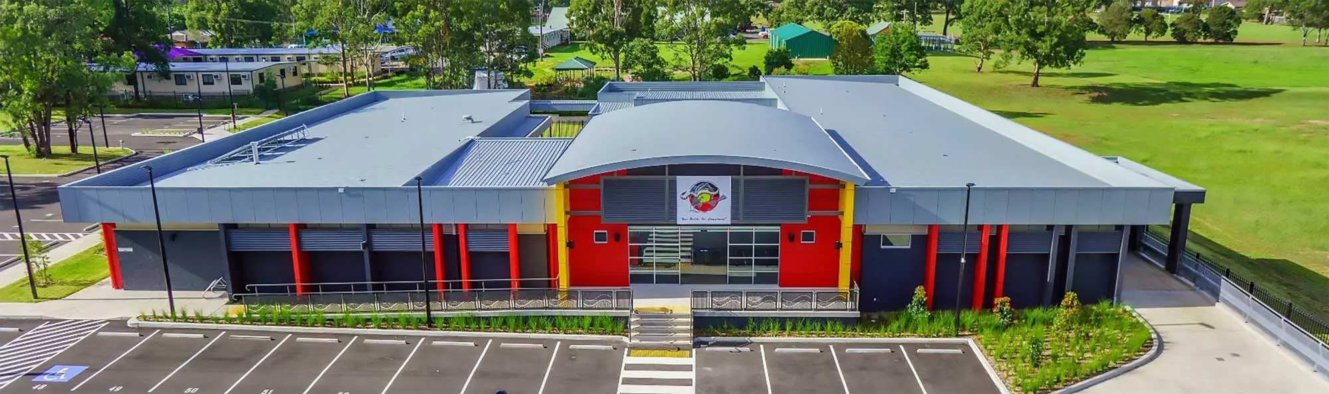
Tharawal Aboriginal Medical Service

Slide 2

Tharawal Services
Medical Services
Dental Clinic
Bullabulla- Maternal & Child Health team
Social and Emotional Wellbeing
Housing
Aboriginal Family Preservation
Oorunga Wandarrah MACS Centre
Waranwarin Early Learning Centre

Slide 3
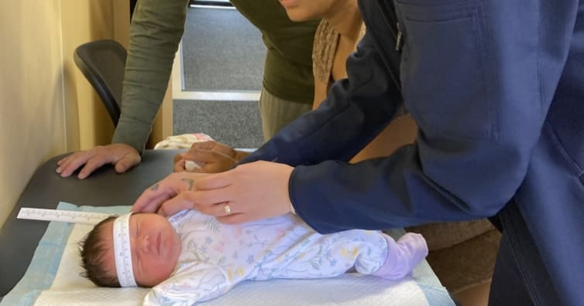

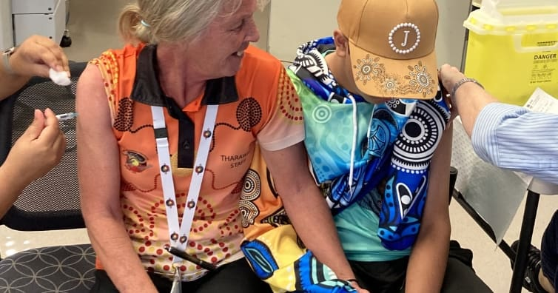
Child Health Check Clinics
Weekly Clinic
Child Health Nurse and GP joint consultation
Child Immunisations and Catch-up schedules
Aboriginal Health Check completed
Development checks

Slide 4
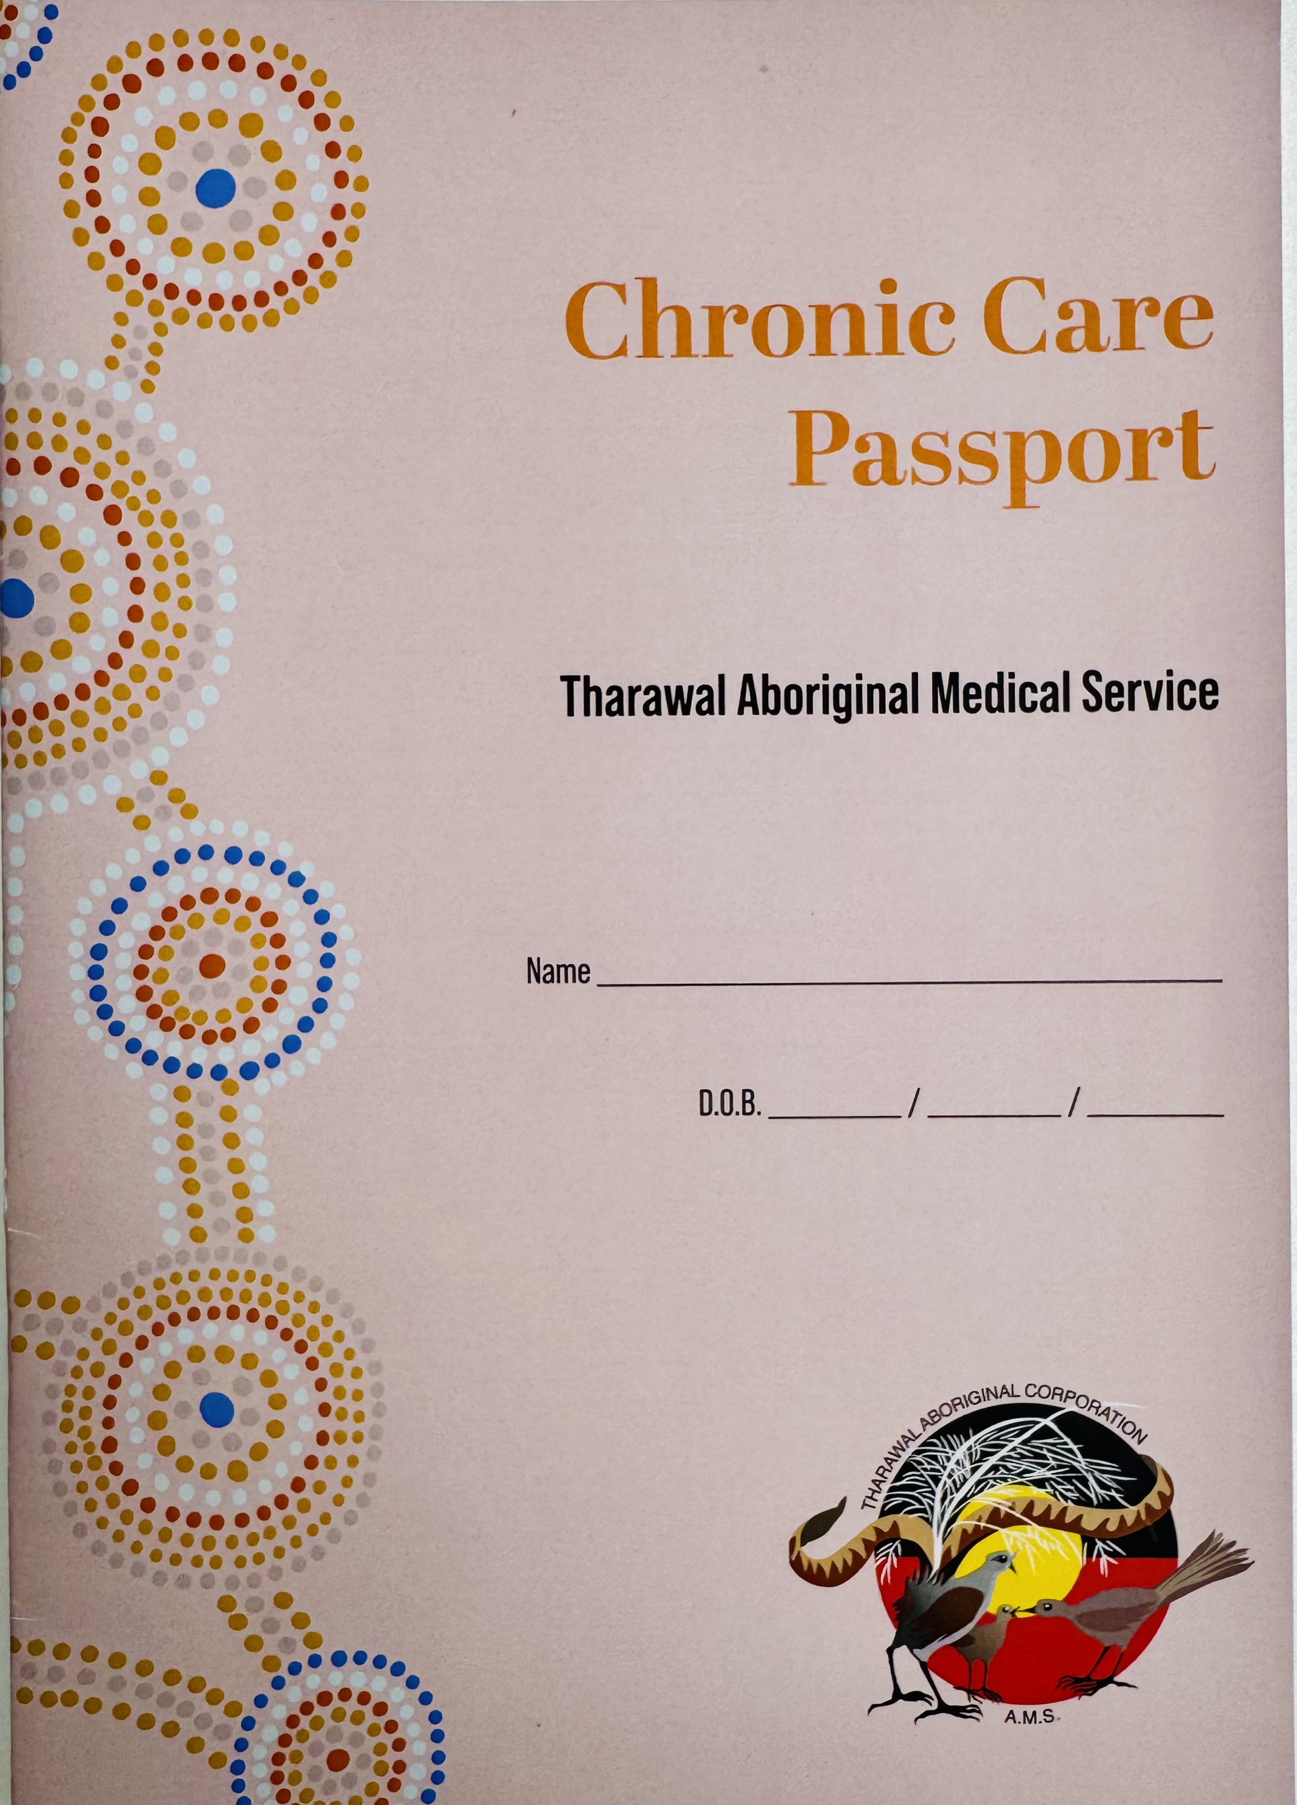
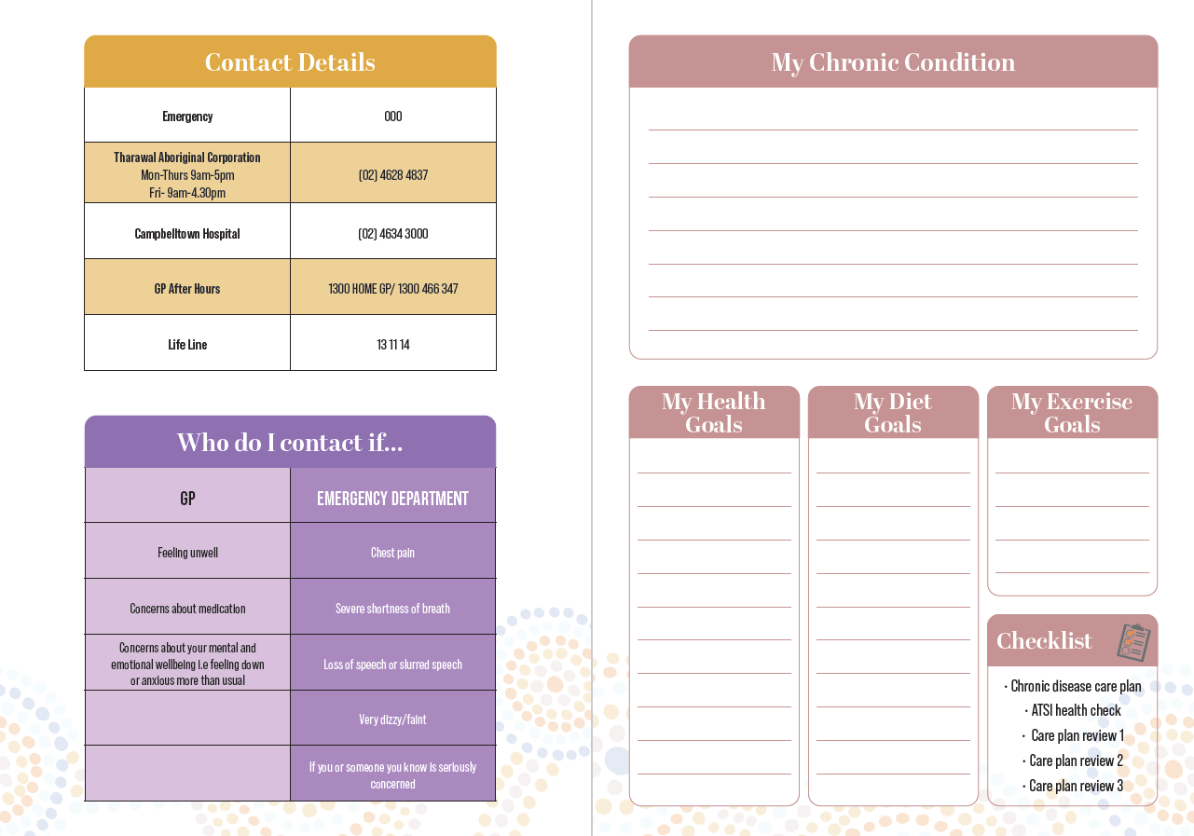
Chronic Disease Clinic
Weekly clinics- Alternating between Diabetes education & Chronic disease care plans.
Incentives when Chronic Disease care plans & reviews are completed.
Currently Implementing our new Chronic Care Passports.

Slide 5
Mental Health Care Plan Clinics
Mental Health Care Plan
Referral for session with Psychology
Mental Health Care Plan Review
Additional sessions with Psychology
Group therapy/ DBT
Weekly GP Clinics located in our SEWB Building
Mental Health Care Plans and Reviews.
Increased engagement in completing the Mental Health Care Plan.
Creates a comfortable environment having MHCP completed in the same department as all our Mental Health Services.

Slide 6


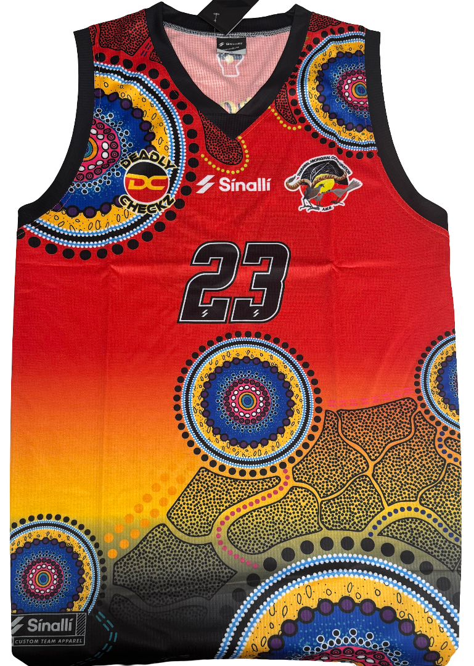


Incentives

Slide 7
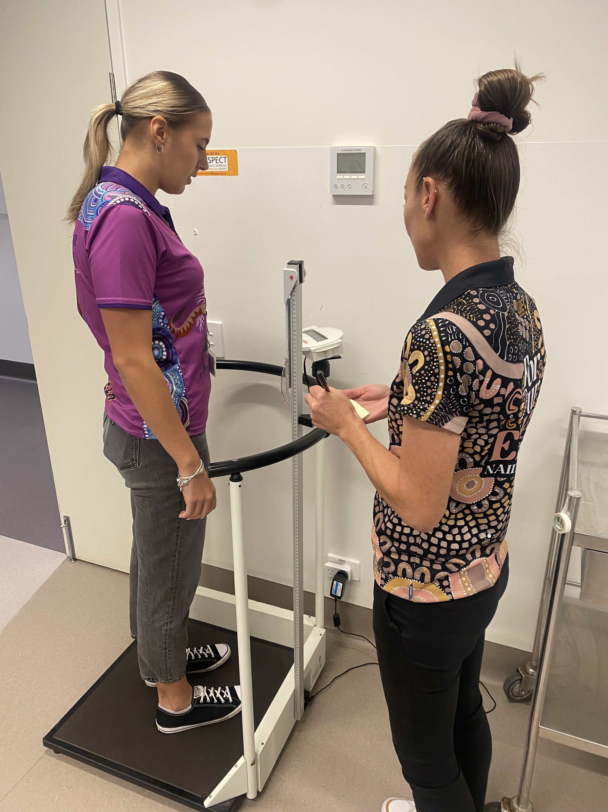
Aboriginal Health Practitioners
4 Aboriginal Health Practitioners who completed the qualifications in 2024 and are now registered with AHPRA
We currently have 4 more staff enrolled to become AHP:
    -1 Aboriginal Health Practitioner Trainee
-1 Aboriginal Outreach worker
-1 Aboriginal Health Worker
-1 Aboriginal Aged Care Worker
Funded through NACCHO

Slide 8
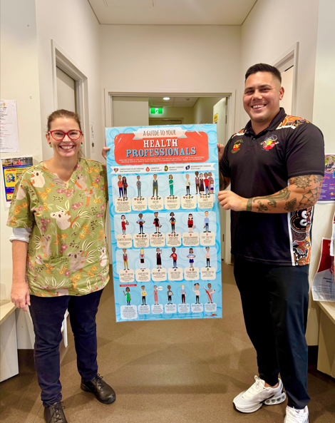
Tharawal’s Specialist Clinics
Audiology
Ears, Nose Throat- Monthly
Hearing Aid Clinics
Endocrinology
Neurology
Geriatrician
Cardiologist- Fortnightly
Echocardiography- Fortnightly
Stress Echo
Podiatry- Weekly
Optometry
Ophthalmology Surgery
Dietician
Diabetes Educator
Pediatrician
Physiotherapist
Gastroenterology
Hepatology
Immunology
Dermatology
Skin Health Clinics
Orthopedic
Renal
Respiratory
Rheumatology
Nephrology
Speech Pathology
Pathology
Psychologist
Psychiatrist
Exercise Physiology

Slide 9
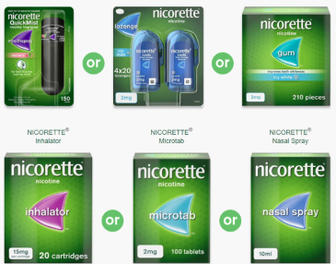
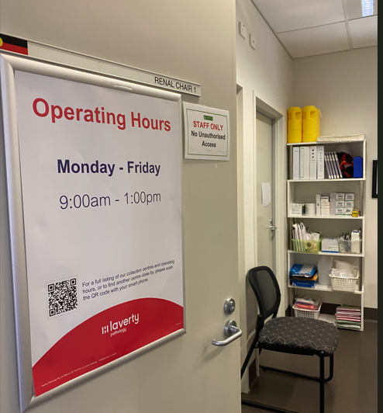
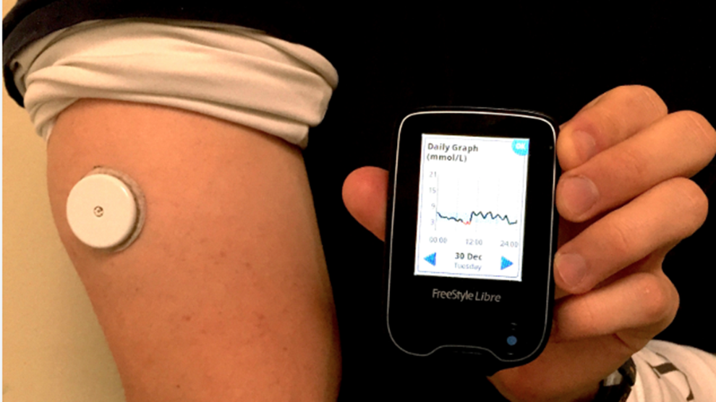
Onsite Pathology
Diabetes Educator
Tobacco Action
FreeStyle Libre sensors
Free 2 weeks for Diabetics
Ordered through Abbott
Previous funding through AH&MRC for NRT replacement.
Ordered direct through Johnson & Johnson, minimum, $5000 order.
Daily Pathology collection onsite through Laverty

Slide 10
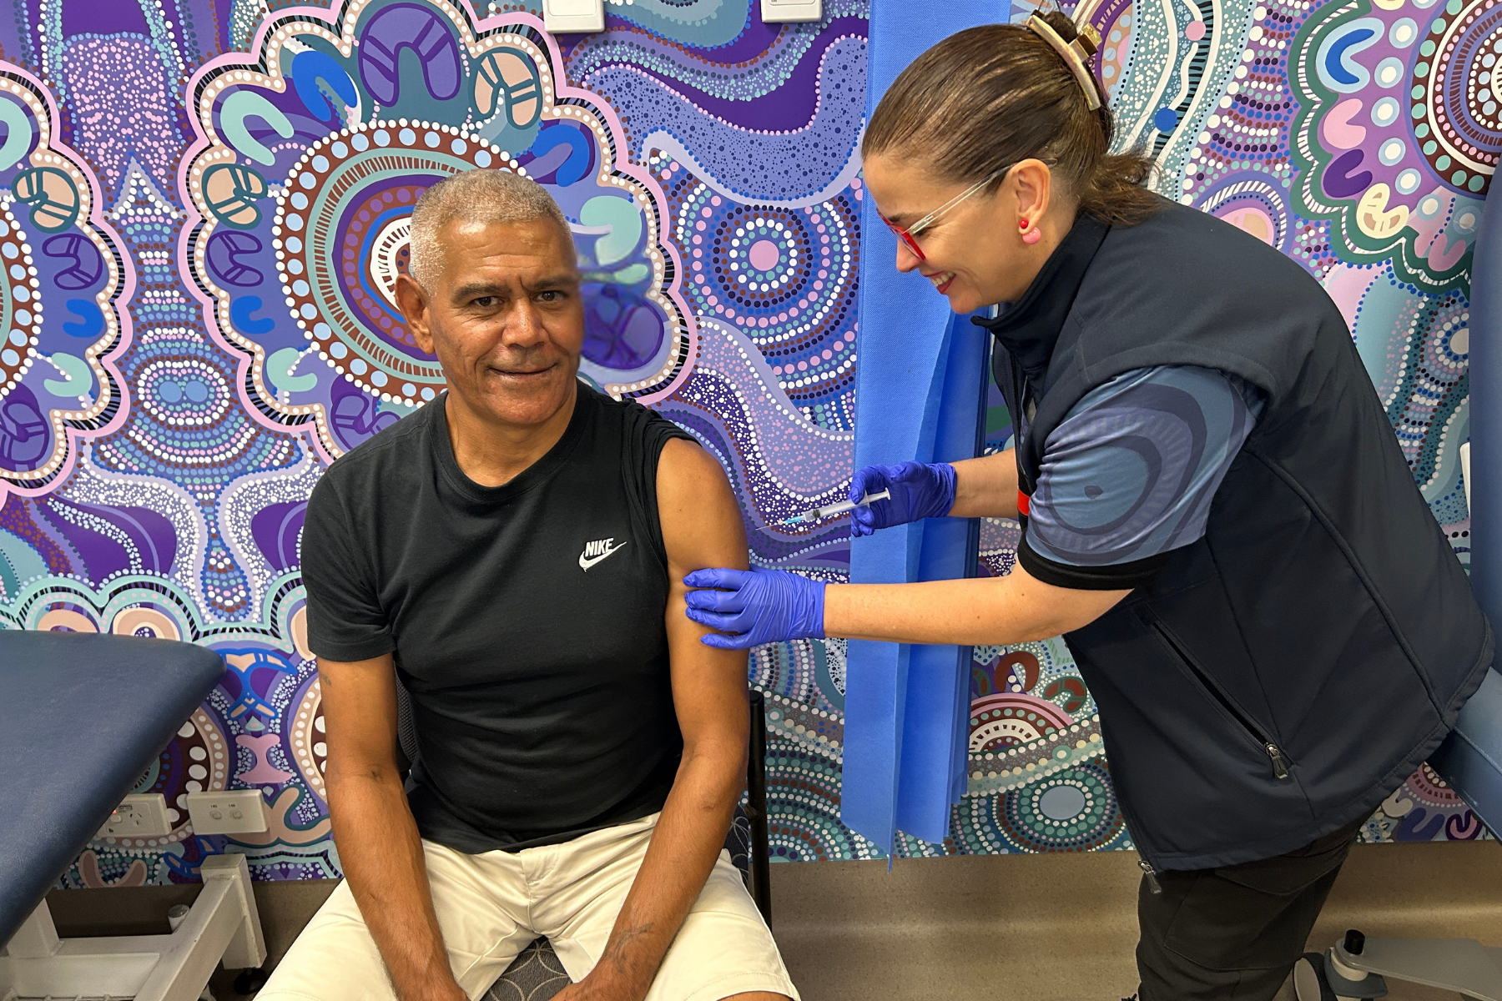
Furry Friends & Flu Fighters
https://swsphn.com.au/news/tharawal-flu-vaccination-clinics/

Slide 11
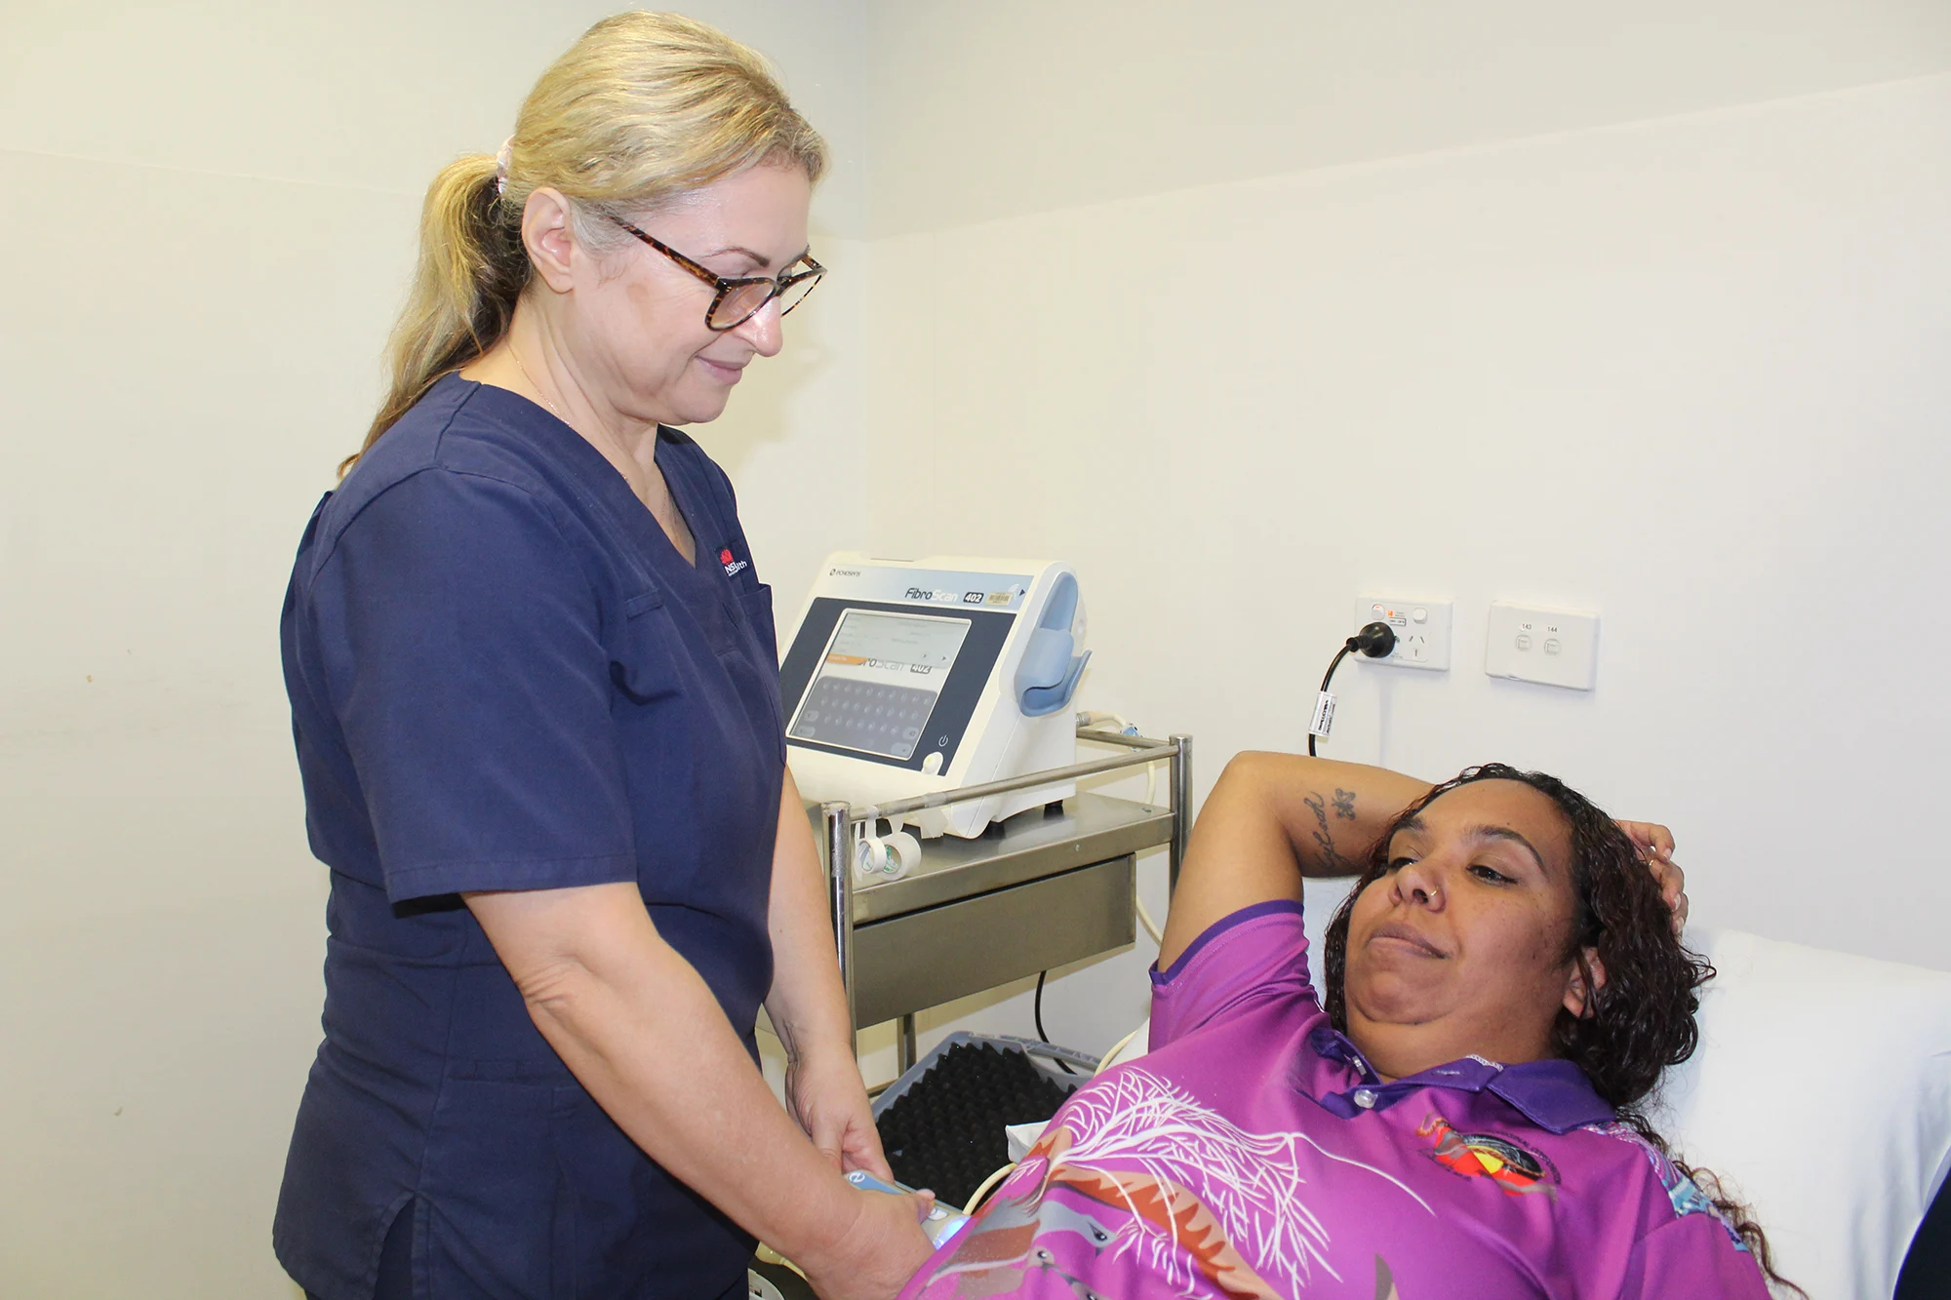
Fibroscan Clinic
https://swsphn.com.au/news/fibroscan-gives-patients-clearer-picture-of-health-of-liver-2/

Slide 12
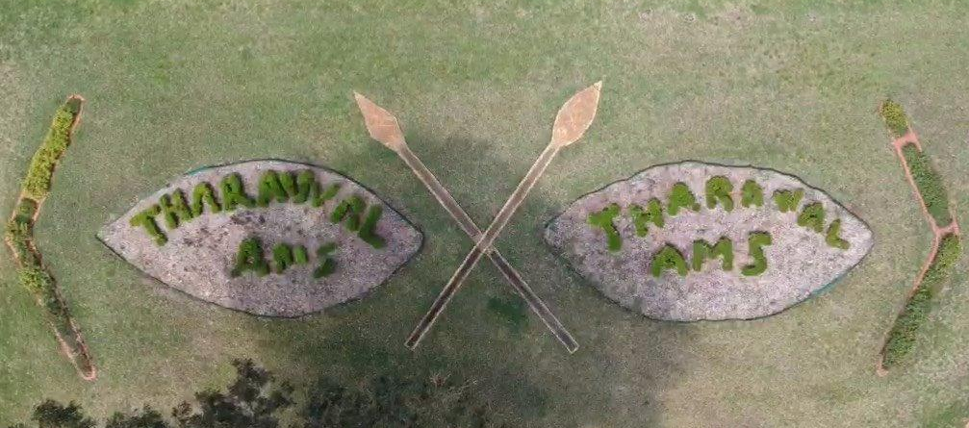
Opioid Dependence Treatment (ODT)
Training
https://swsphn.com.au/news/eois-sought-for-practices-to-provide-opioid-dependence-treatment/

Slide 13




Partnership/Funding
Rural Doctors Network (RDN)
Southwest Sydney Local Health District (SWSLHD)
PHN South-Western Sydney
Medicare Benefit Schedule (MBS)
Aboriginal Chronic Care Program (ACCP)
NACCHO

Slide 14
Patient Journey
Ears, Nose and Throat Pathway
Aboriginal Health check with AHP & GP
ENT Referral
Consult with ENT specialist at Tharawal AMS
Hospital Admission Paperwork completed
ENT Surgery
Performed
Post-Op ENT consult at AMS
Follow-up testing coordinated by AHP
Every step in the ENT process is coordinated and monitored by our Aboriginal Health Practitioner.

Slide 15
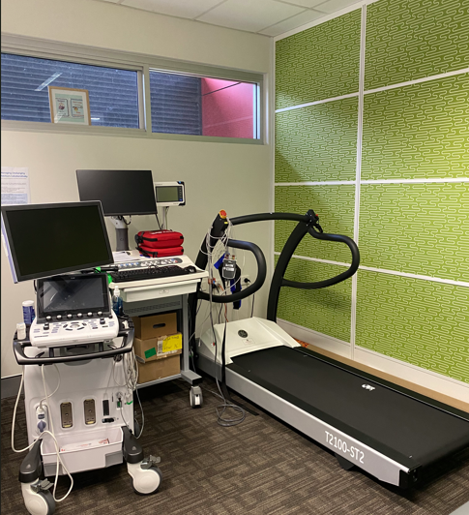
Cardiac Clinic
Cardiology Specialist Clinic- Fortnightly
ECG before all Cardiology appointments
Echocardiograph (Heart Ultrasound)- Monthly
Stress Echocardiograph (treadmill + Heart Ultrasound)- Monthly

Slide 16
Cardiology Pathway
Patient Journey
Aboriginal Health check with AHP & GP
Cardiology Referral
Consult with Cardiologist at AMS
Echocardiograph at AMS
Consult with Cardiologist
Stress Echocardiogram at AMS
ECG completed by AHP on day of consult

Slide 17













Thank-you

