Slide 1



Allied Health
The walu-win Model
AH&MRC State CQI Forum
June 2025

Slide 2
Presentation Outline
An Overview of The Walu-Win Centre
Financial Sustainability
The Patient Journey to Walu-Win
The Allied Health Assistant Model
Upcoming Hydrotherapy Services
Notes:
Good morning, My name is Josh and this is Ash and we will be taking you on a journey through The walu-win Centre at OAMS.
In this presentation, we will be walking you through several key themes that are central to the work we're doing at The walu-win Centre. These include:
An Overview of The Walu-Win Centre – what we offer and how we support our community
Financial Sustainability – ensuring the longevity and impact of our services
The Patient Journey to Walu-Win – a recurring focus throughout today’s discussion, highlighting how client's access and experience our care
The Allied Health Assistant Model – how we’re evolving our workforce to meet client needs more efficiently
Upcoming Hydrotherapy Services – a look at our exciting new facility and how it will enhance service delivery
Each of these themes plays a role in shaping a more effective, accessible, and sustainable future for Walu-Win and the people we serve.

Slide 3
Acknowledgement
I acknowledge the Traditional Custodians of the land that we are gathered here today, the Gadigal people of the Eora Nation. I pay my respects to the Elders past and present and acknowledge their continuing connection to the lands, waters and culture.
I would like to also acknowledge the land that I am visiting from today, Wiradjuri Country and extend my respects to the Elders that have looked after the land that I am privileged to live and work on for the last 32 years.
Notes:
Firstly, Id like to acknowledge that I am a visitor here on Gadigal Land. I would like to pay my respects to the Elders of this land, past and present.
I am visiting from wiradjuri country, just over the mountains and would also like to pay my respects to the Elders of the land that I have had the privilege to live and work on for 32 years.

Slide 4
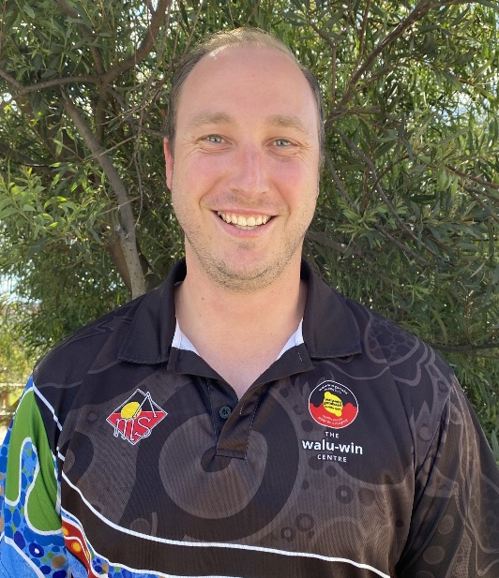
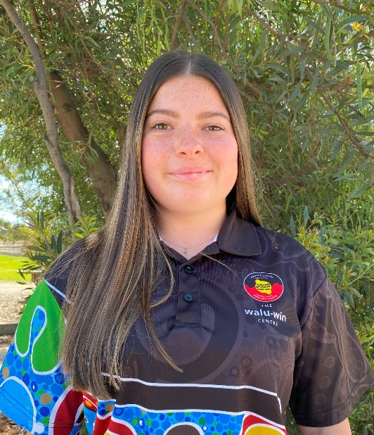
Bio’s – Who are we?
Name:
Josh
Role:
Accredited Exercise Physiologist / walu-win Manager
Years at OAMS:
5 Years (Aug 2025)
Born and raised in Bathurst, NSW, I completed my Bachelors in Exercise Science (2013) and Masters in Clinical Exercise Physiology (2019) through CSU. I am passionate about getting our clients well, using exercise and lifestyle intervention to improve the quality of life of the community. “Exercise is Medicine”.
Name:
Ashley
Role:
Allied Health Assistant (in training) / walu-win Care Navigator
Years at OAMS:
1 Year
I was born and raised on Wiradjuri country in Orange, NSW. I started my role as a care navigator at OAMS about a year ago and started my training to become an allied health assistant soon after. I hope to complete my certificate 4 in allied health assistances before July. It has been a privilege to learn and grow at OAMS, their support and encouragement has help me achieve many things.

Slide 5

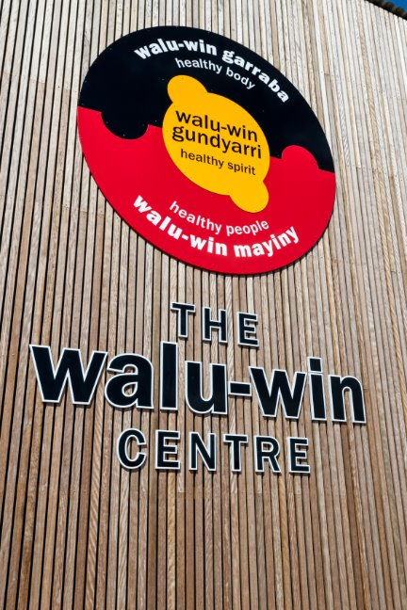
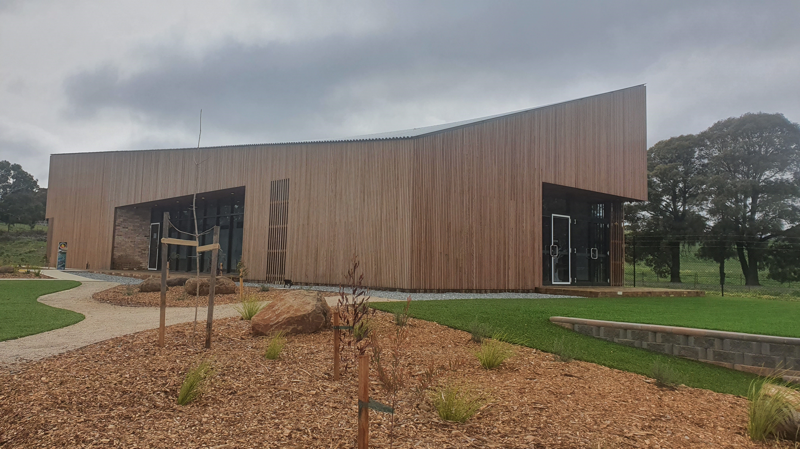
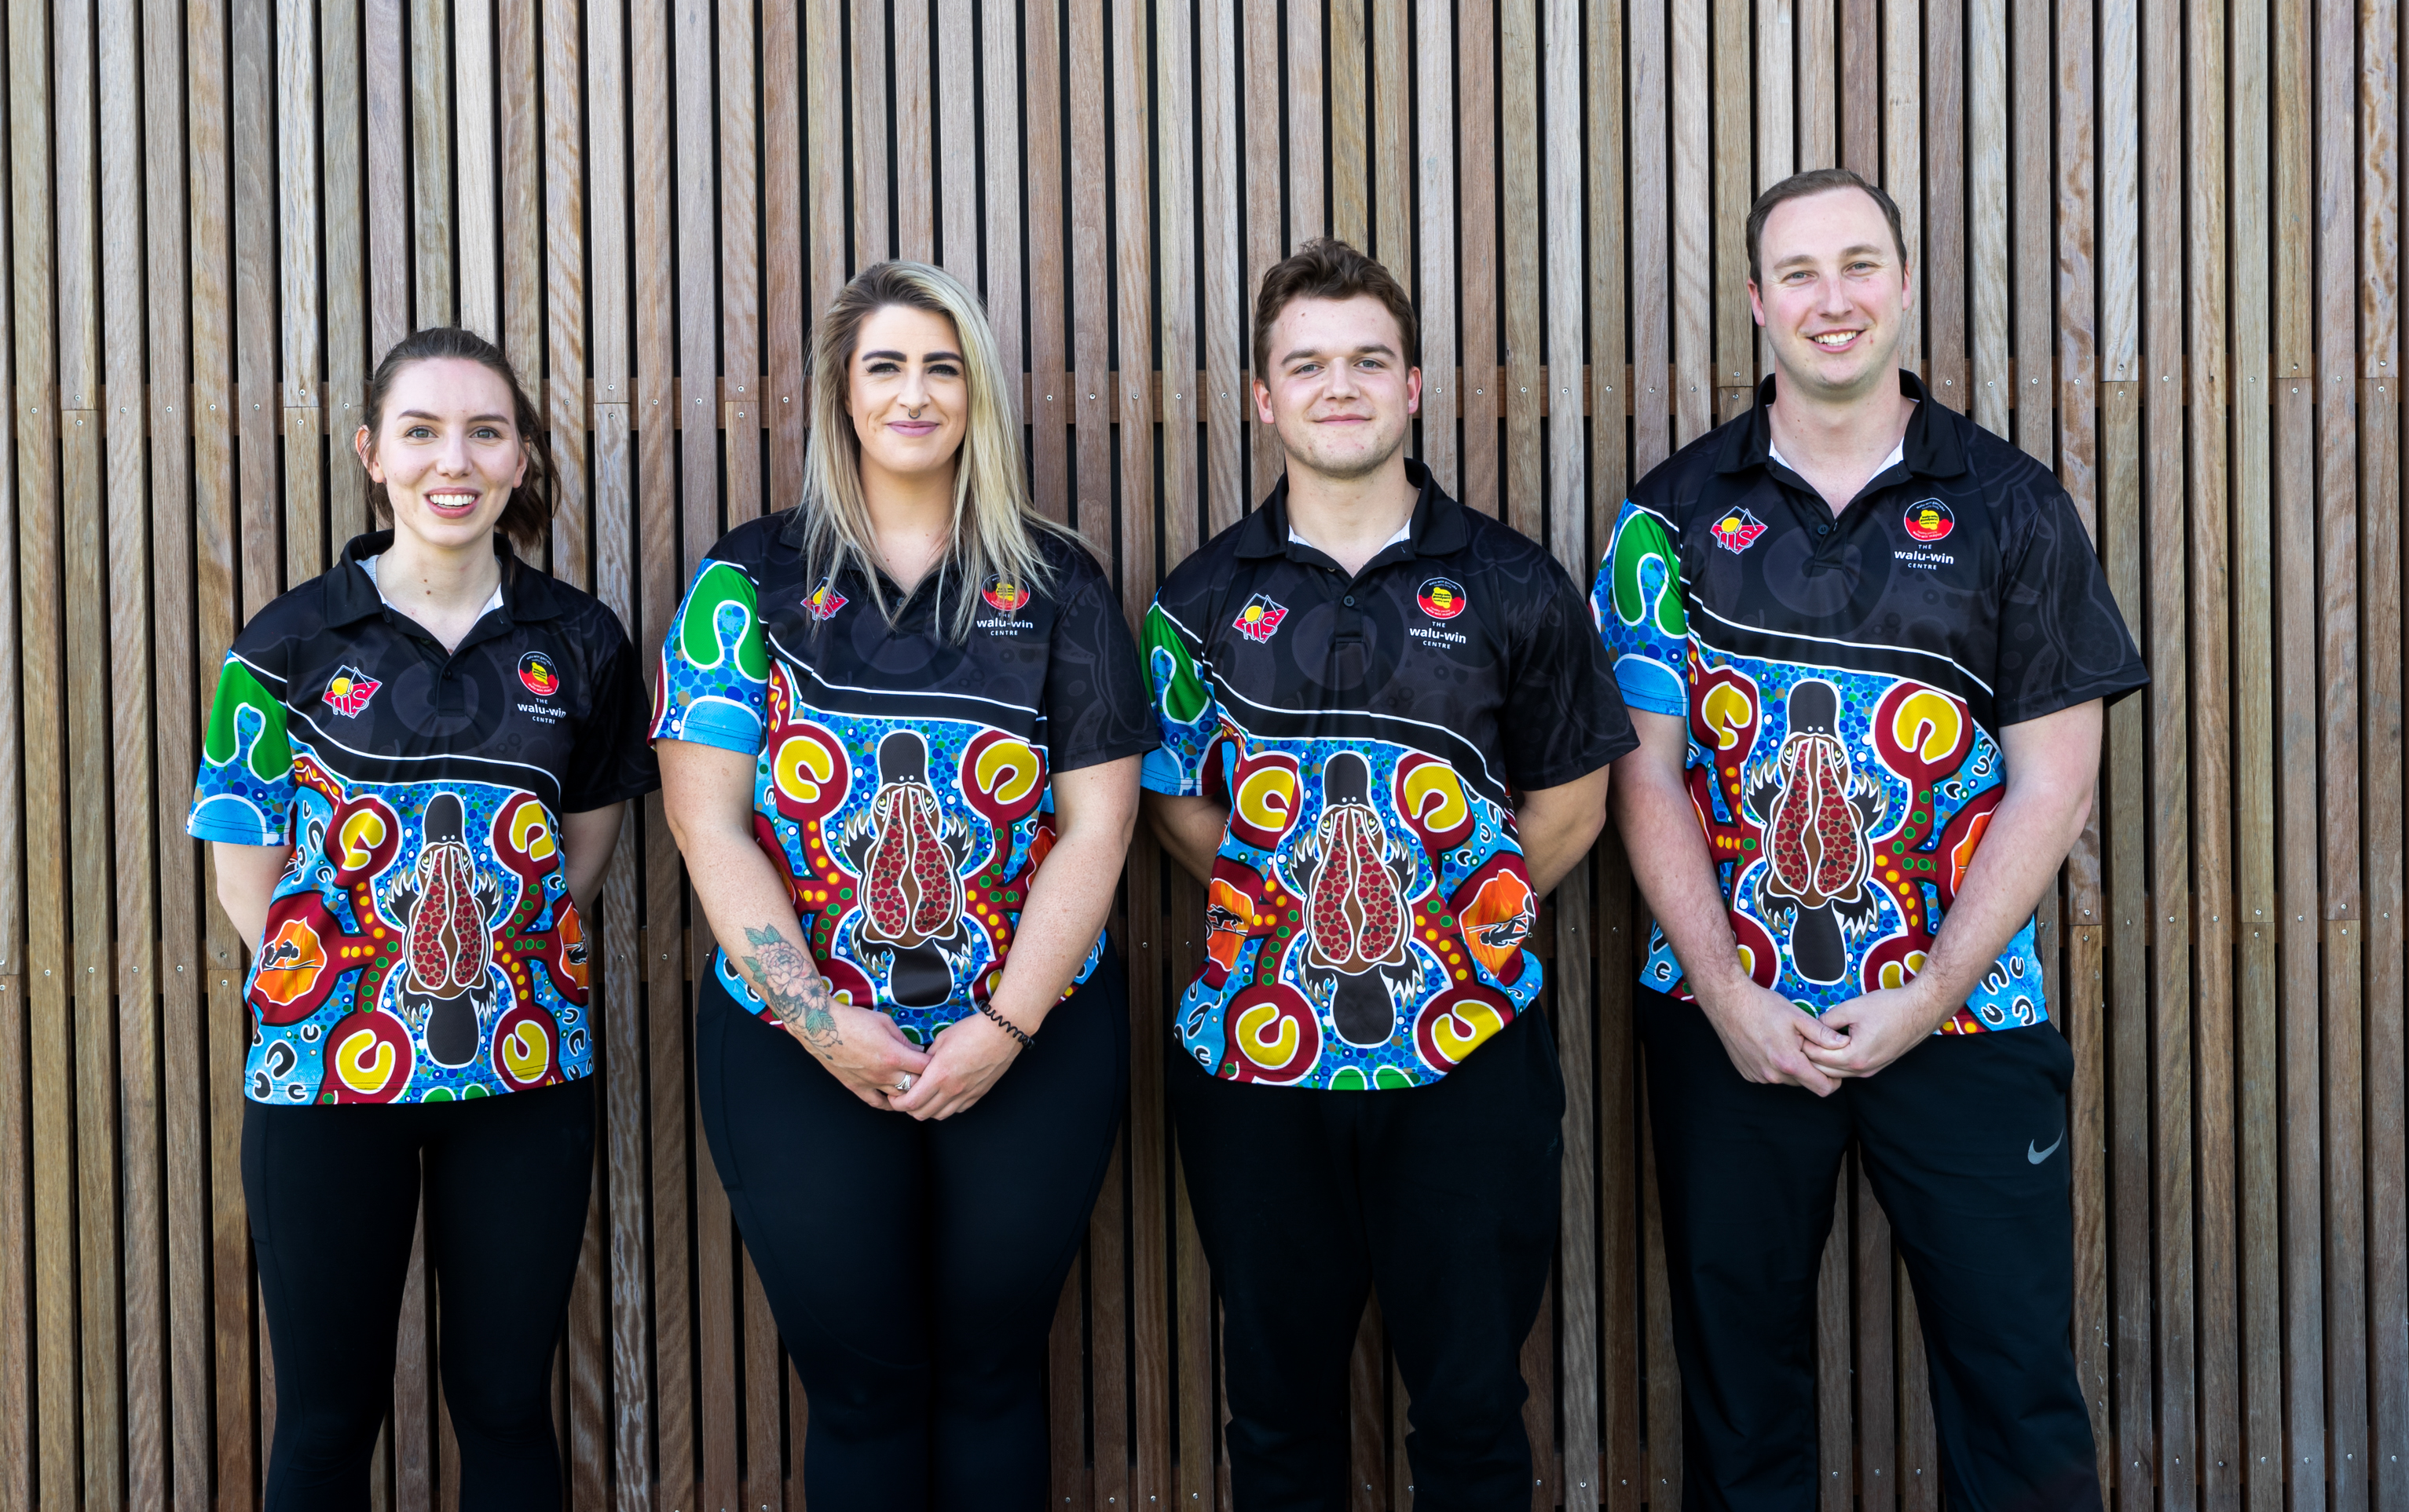
The walu-win Centre
'walu-win' in Wiradjuri language means 'healthy' or 'wellbeing’
The centre was built in late 2019 and opened in 2020. The centre boasted a rehabilitation space, exercise facilities and consultation spaces.
Staffing began with:
walu-win Centre Manager
2 x Identified walu-win Coach roles.
Shortly later in 2020, OAMS employed an Exercise Physiologist (me).
Notes:
Waluwin means ‘Healthy’ in Wiradjuri.
Built in late 2019, opened early 2020. Launched with:
A Centre Manager
Two identified Waluwin Coaches with Certificate III in Fitness
Shortly after opening, COVID-19 restrictions began.
Our team quickly adapted by:
Moving services online
Sharing health and fitness videos on social media
In August 2020, following the initial lockdown: OAMS employed a full-time Exercise Physiologist (me). We began offering client consultations and expanding our Exercise Physiology service.

Slide 6
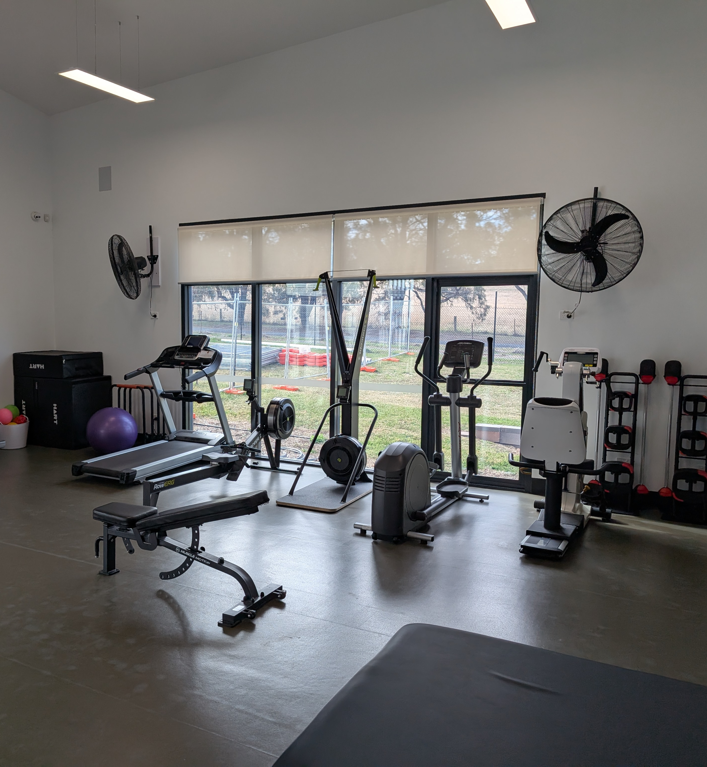
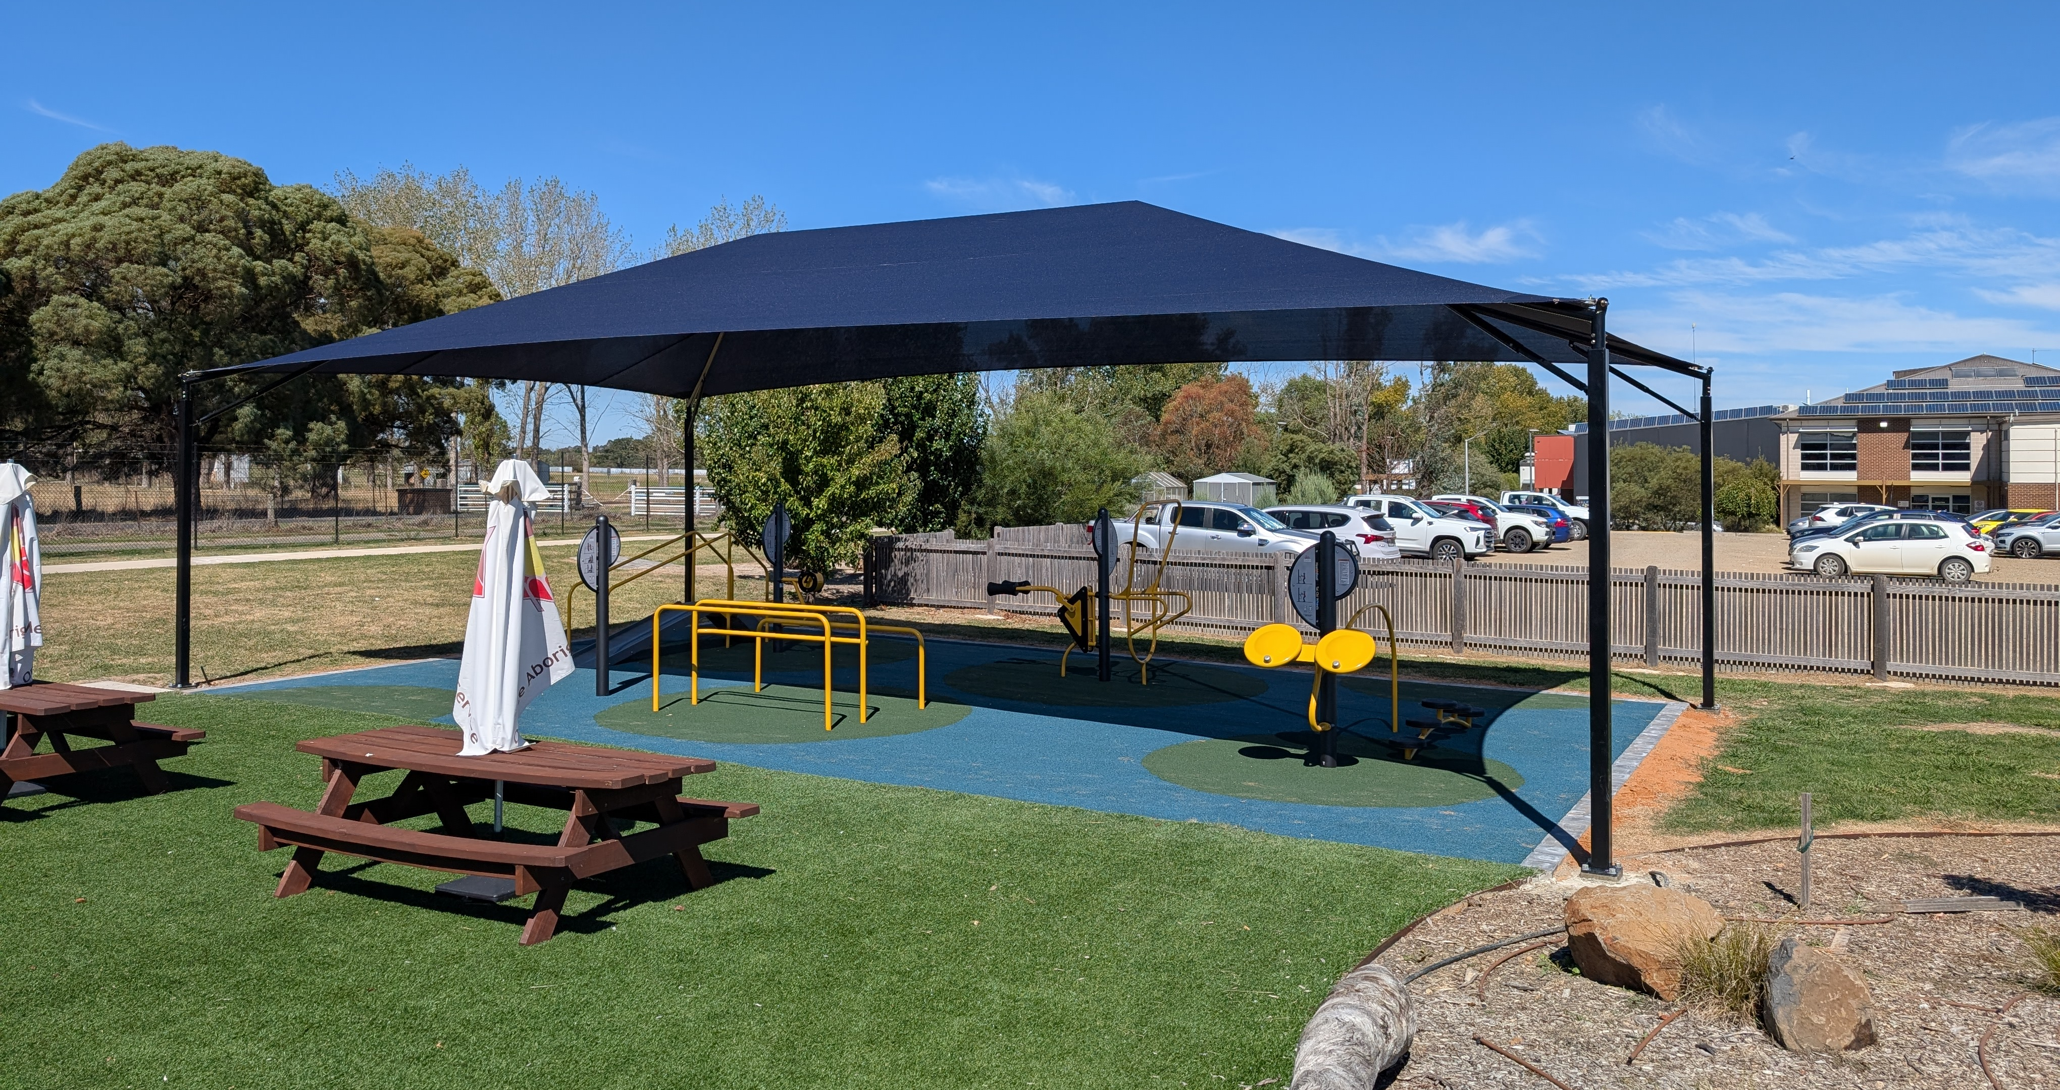
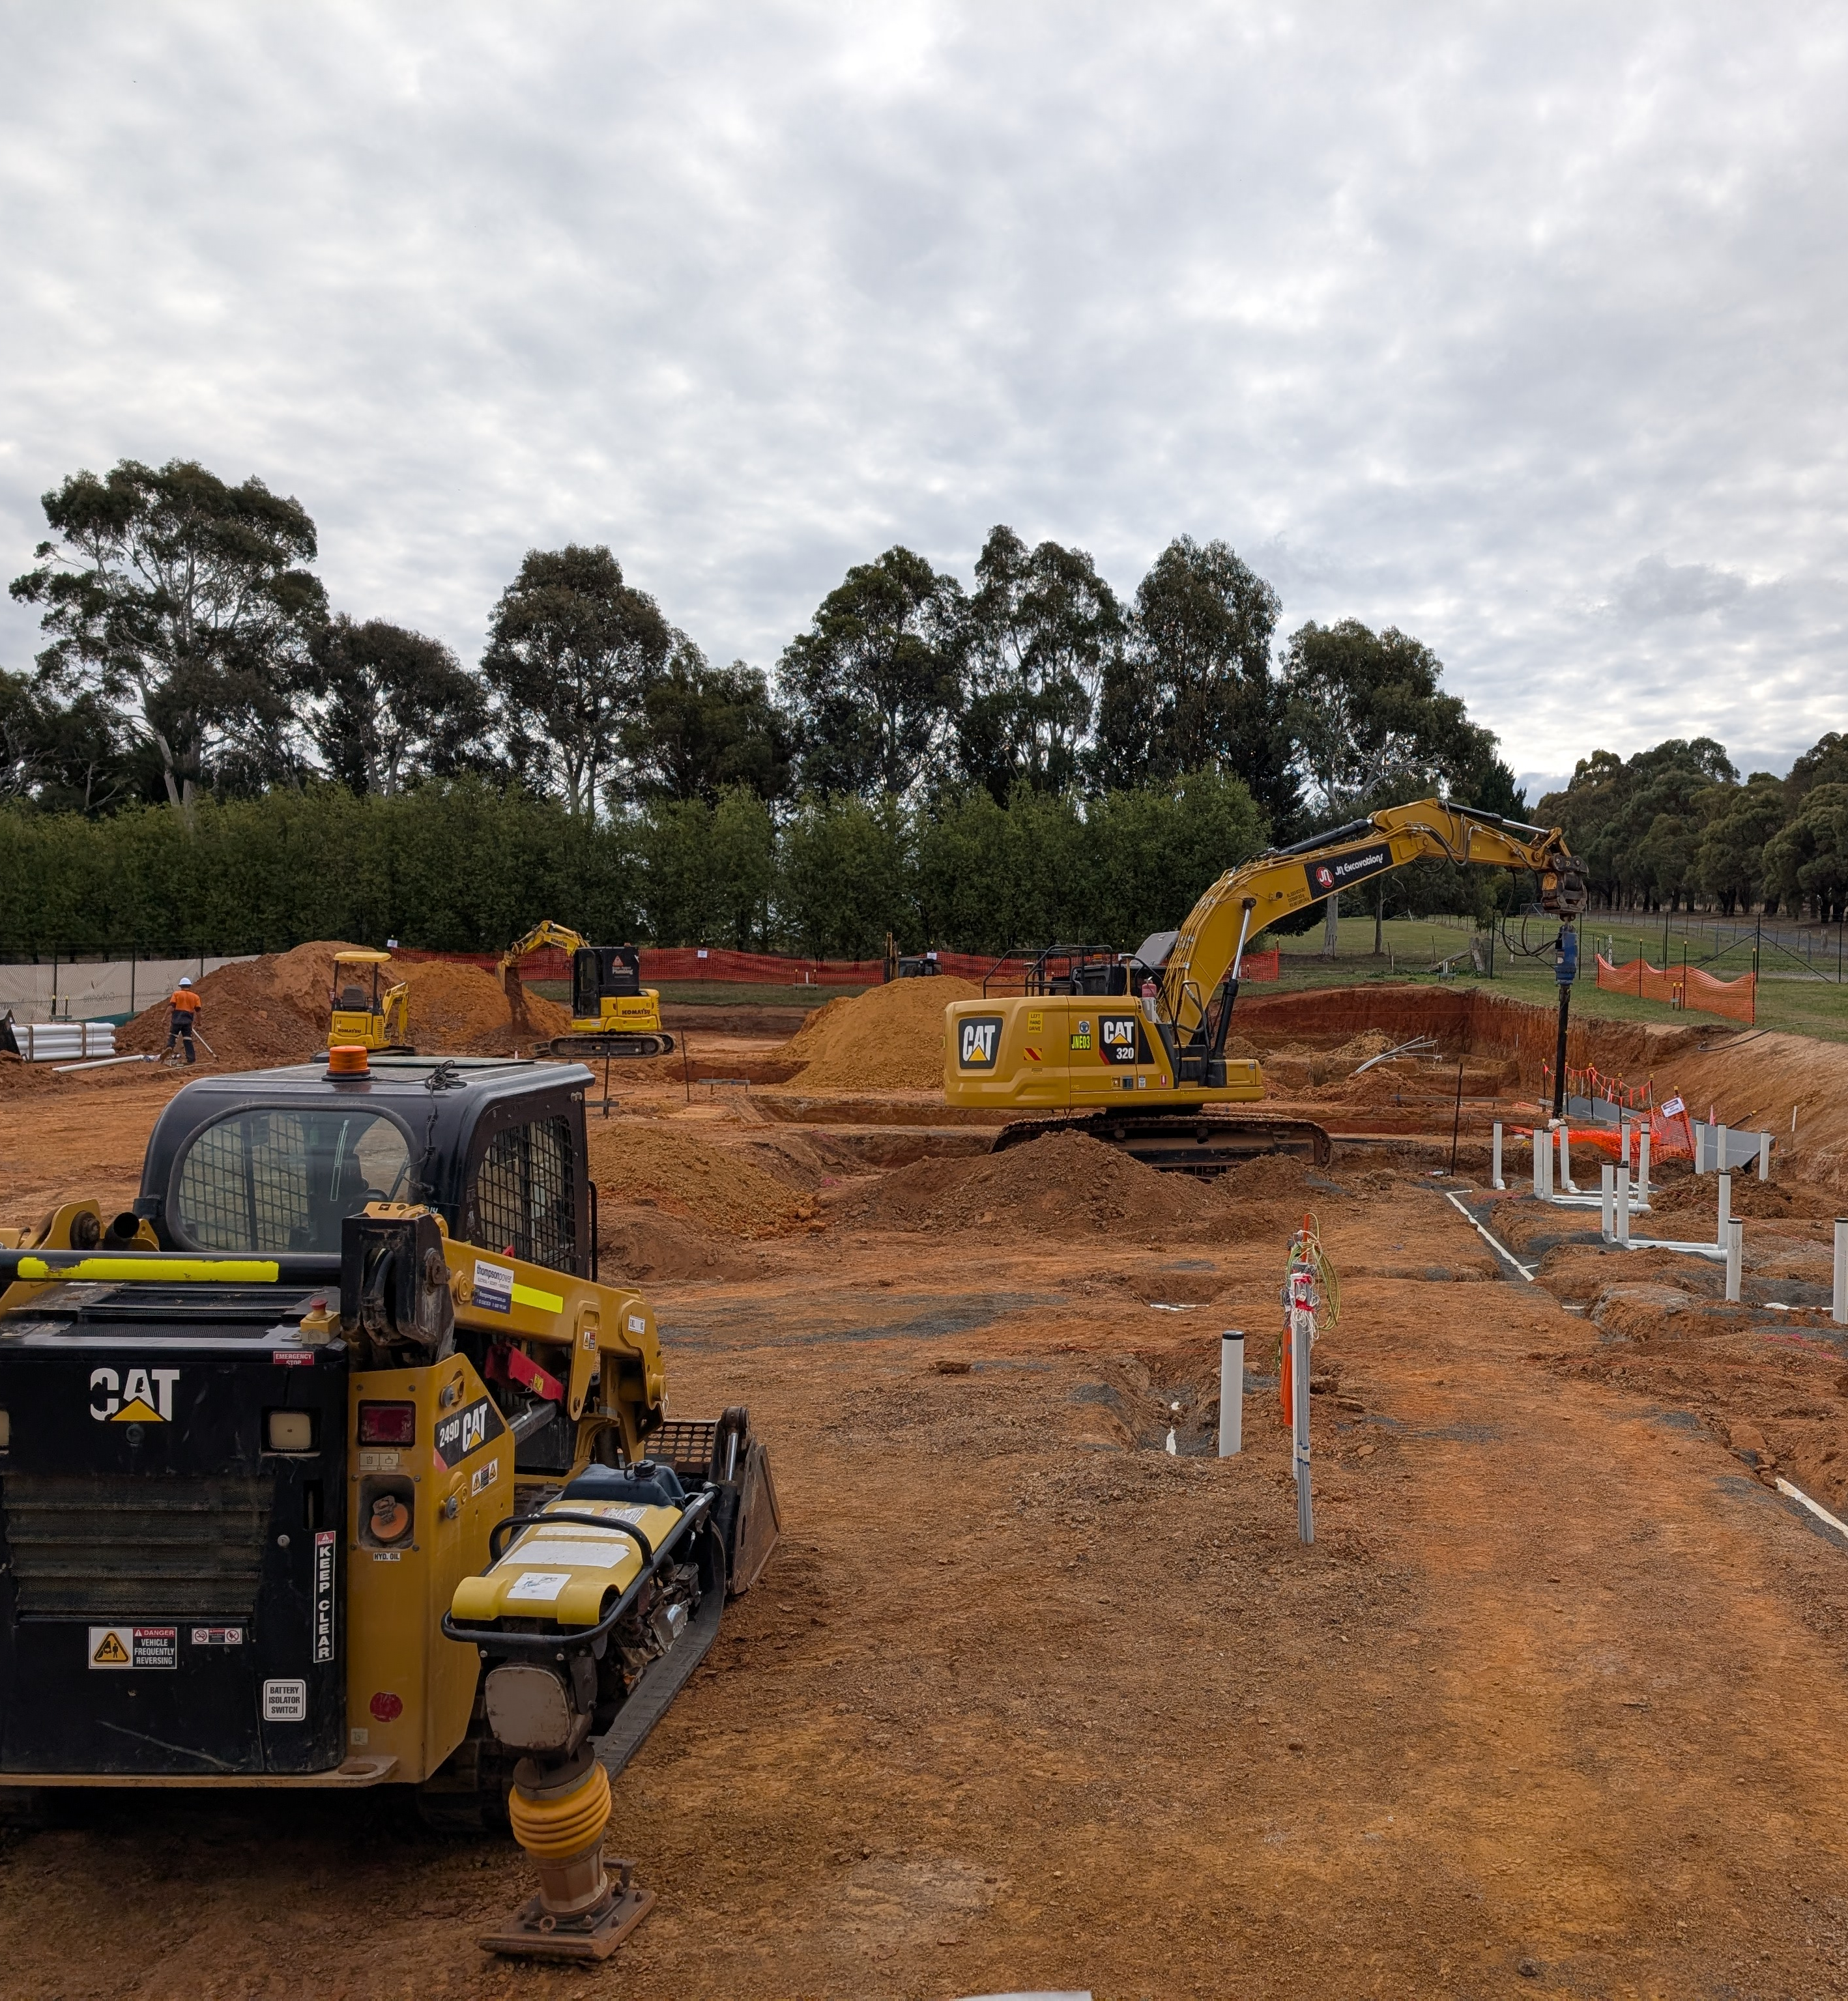
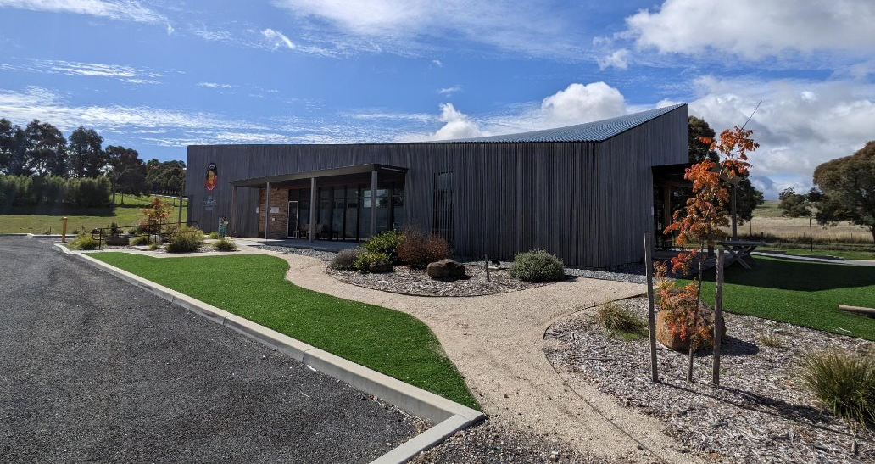
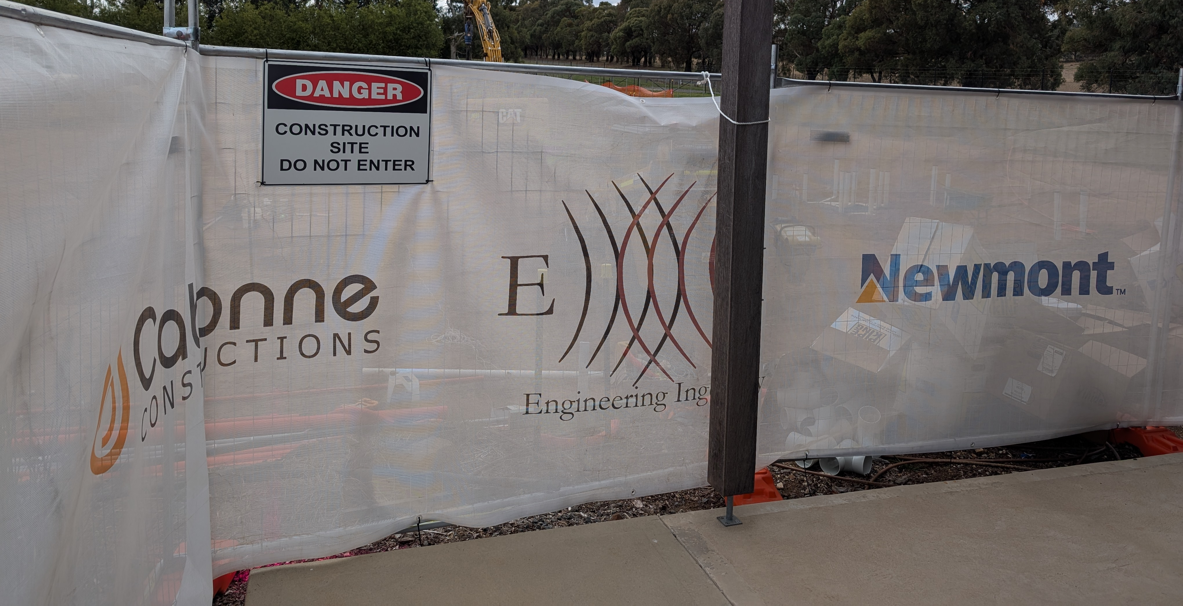
The walu-win Centre 2025
Notes:
Since opening, Waluwin has continued to grow and adapt to better meet the needs of our community.
Key Updates:
Minor renovations to expand office space and support a growing team.
Installation of outdoor exercise equipment to support diverse fitness programs.
Currently under construction we have a new Waluwin building featuring a Hydrotherapy Pool, which will further enhance our rehabilitation and wellness services.

Slide 7
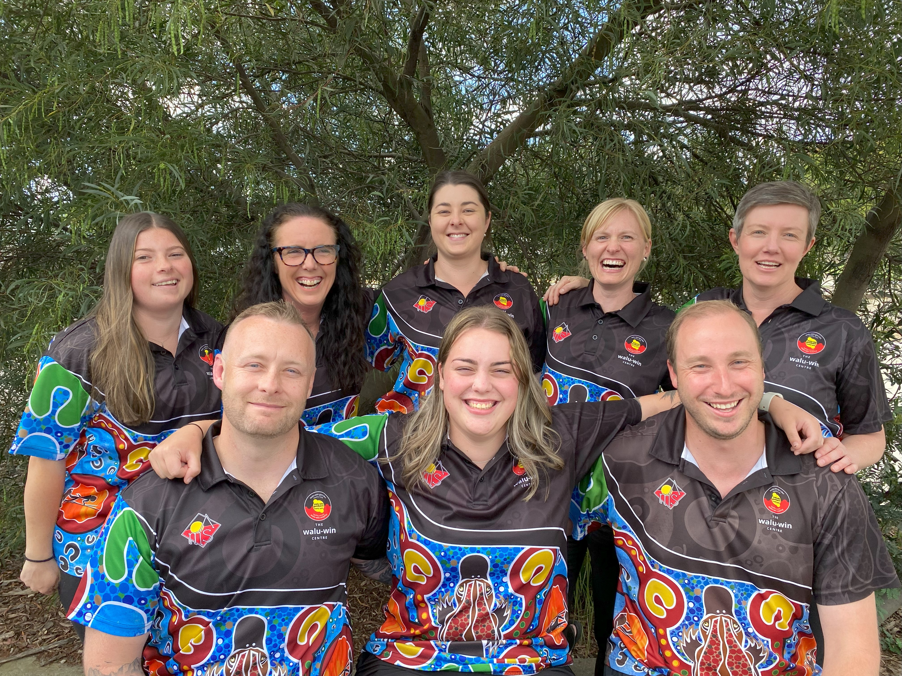
Allied Health at OAMS
The walu-win Centre is the Allied Health Hub of OAMS​
Workforce:​
Credentialled Diabetes Educator and ​Consultant Pharmacist​
2 x Accredited Exercise Physiologists (1 FT, 1 PT)​
Dietitian (FT)​
2 x Physiotherapist (2 PT)​
3 x Allied Health Assistant (1 qualified, 2 Trainees) (1 FT, 2 PT)​
2 x Tackling Indigenous Smoking Workers (2 FT)​
walu-win Coach (PT)​
walu-win Care Navigator​
Sports GP (visiting)
Notes:
Over the past 12–18 months, staffing at Waluwin has expanded significantly to meet increasing demand and broaden our service offerings.
Current Staff at Waluwin:
1 Diabetes Educator
2 Exercise Physiologists
1 Dietitian
2 Part-Time Physiotherapists
2 Tackling Indigenous Smoking (TIS) Workers
3 Allied Health Assistants, with dual roles:
One also serves as a Personal Trainer
One also works as a Care Navigator
Visiting Sports Doctor – available monthly
This multidisciplinary team ensures we provide holistic, culturally safe care to our community.

Slide 8
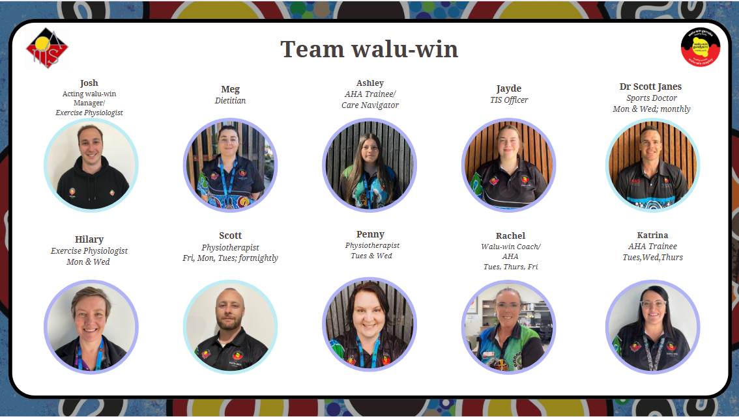
Meet our team!
Notes:
Here is another look at our team and their role’s

Slide 9
Current Allied Health Activities
Current Activities | Staff | Funding Sources
One-on-one client consultations | EP, CDE, DT, PT Optometry, podiatry walu-win Coach/AHA trainee Psychology | Medicare ($60.35 x 5-10/year) NDIS NSW Rural Doctors Network (Medical Outreach Indigenous Chronic Disease Program – MOICDP; supporting employed & visiting clinicians) SARRAH BRAHAW program Commonwealth Home Support Programme (CHSP)
Group exercise classes | walu-win Coach & EP
Lifelong Strength & Wellness (Healthy Aging) | EP, DT, Care Navigator/AHA trainee | Western NSW Primary Health Network (WNSW PHN)
Healthy Connections (Healthy Aging) | EP, DT, Care Navigator (Transport officer) | Commonwealth Department of Communities & Justice (DCJ)
Type 2 Diabetes Group Program | EP, DT, CDE | Medicare
Corporate Health Program | EP, walu-win Coach
University Student Placements – allied health | EP, Manager
Speech pathology screening Hearing screening | Child Health Navigator (AHA) (visiting LHD SPs)
Health Promotion | Tackling Indigenous Smoking team | Griffith Aboriginal Medical Service (GAMS)
Notes:
1. Core Clinical Services
At Waluwin, our core clinical services focus on delivering personalized consultations and tailored sessions across multiple disciplines:
Physiotherapy
Exercise Physiology
Dietetics
Personal Training
These services form the foundation of our commitment to improving individual health and wellbeing.
2. Group Classes
We currently run 7 group fitness classes per week, including:
A general fitness class
A class tailored for women over 45
A dedicated teen girls class
Each class has a capacity of 10 participants, and we are pleased to see attendance nearing full capacity across the board.
3. Community-Funded Programs
We deliver two funded programs supporting the Orange community:
Healthy Ageing Program
Focused on fall prevention for older adults, this initiative includes:
Strength and balance training
Nutrition support and education
Social Connections Program
Aimed at reducing social isolation, this program fosters community ties through:
“Walk and Talk” sessions with coffee
Cooking and sharing a meal with one another
4. Diabetes Education Program
Through Medicare funding, we offer an 8-week Type 2 Diabetes Group Program, which includes:
A Dietitian
A Diabetes Educator
An Exercise Physiologist
This collaborative approach supports participants in managing their condition effectively.
5. Student Education & Placement
Waluwin proudly hosts university students from:
Physiotherapy
Exercise Physiology
Occupational Therapy
We offer both project-based placements and clinical physiotherapy placements, contributing to the development of future healthcare professionals.
6. Health Promotion – Tackling Smoking & Vaping
Our TIS (Tackling Indigenous Smoking) team leads health promotion initiatives around smoking and vaping cessation by:
Attending community events and schools
Delivering educational sessions focused on quitting and staying smoke-free
7. Allied Health Assistant Support
Our Allied Health Assistants (AHAs) also support visiting speech and hearing clinics, ensuring broader access to essential communication and auditory services.

Slide 10
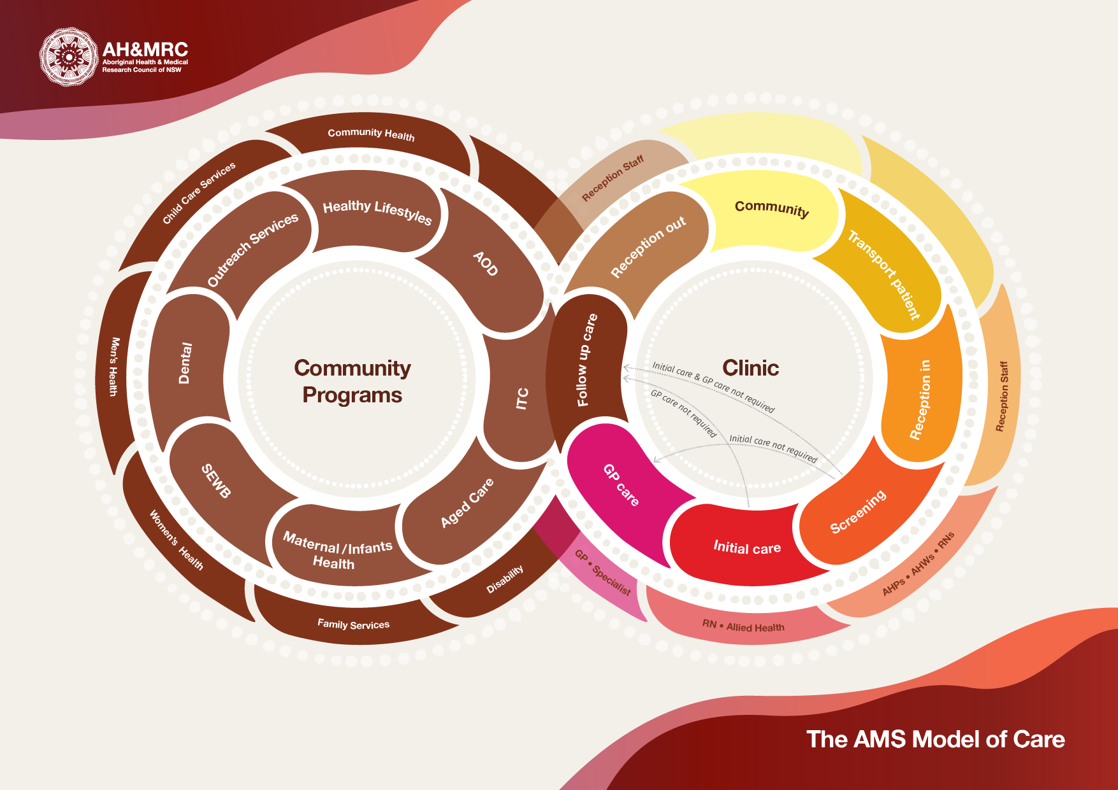

Notes:
- As we know, this is the AMS model of care.
- And this is where we sit in this model.

Slide 11

The walu-win Centre Sustainability
Initial Appointment for GPMP / AHC
Service Delivery
Review and continuity of care
Cycle Repeats
Primary Income: Medicare
Notes:
Initial GP Appointment/Health Check
Ensures care plans are up to date.
GP completes referrals (EPCs) to Waluwin allied health services.
Service Delivery
Client engages with services (e.g., 8 exercise sessions for chronic back pain).
Review & Continuity of Care
Allied health provider sends the patient back to the GP for a GPMP review.
Cycle Repeats
Ongoing monitoring, review, and support as needed.
This cycle not only ensures continuity of care but also supports sustainable service delivery.
Waluwin’s services are funded through a diverse mix of income sources, supporting both access and sustainability: The main being Medicare Billing
Directly: Through EPC appointments (e.g., Exercise Physiology, Dietetics)
Indirectly: GPs bill for health checks and reviews tied to care plans

Slide 12

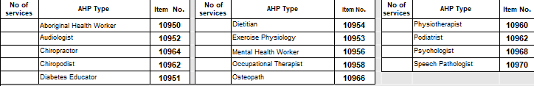
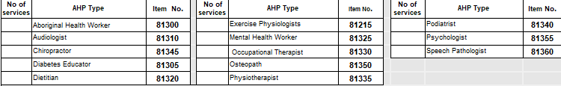
Medicare Benefits Scheme Items
GPMP and EPC’s
(max 5 per calendar year)
Diabetes Educator
Exercise Physiologist
Dietitian
Physiotherapist
715 AHC and EPC’s
(max 5-10 per calendar year)
Diabetes Educator
Exercise Physiologist
Dietitian
Physiotherapist
Notes:
As allied health professionals, we are able to bill the following number at waluwin.
As we also know, we are only able to bill a maximum of 10 per calendar year, including 10 under a patients Aboriginal Health Check and only 5 under their chronic disease management plan.
At Waluwin, our Allied Health Professionals can bill Medicare under two primary streams:
Aboriginal Health Check (MBS Item 715)
Patients who complete an Aboriginal Health Check are eligible for:
Up to 10 Allied Health sessions per calendar year
Chronic Disease Management Plan (CDM / GPMP + TCA)
Under this plan, patients are eligible for:
Up to 5 Allied Health sessions per calendar year
It is important to note that a person is only eligible for a maximum of 10 services per calendar year across both plans.

Slide 13
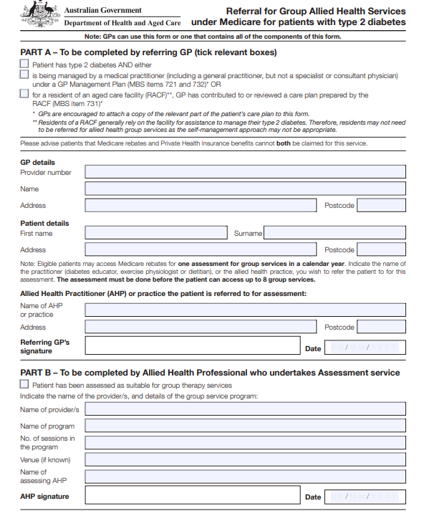
T2DM Diabetes Program
8 Week Diabetes Program
Diabetes Educator, Dietitian, Exercise Physiologist
Education for self-management
Exercise and dietary advice
Medicare claimable
  1 x Consult - $77.40
  8 x Group Sessions - $19.30
Notes:
At Waluwin, we deliver a Type 2 Diabetes Group Education Program – the only group program funded by Medicare.
Program Details:
Designed for clients with Type 2 Diabetes
Delivered over 8 group sessions
Includes input from:
Exercise Physiologist
Dietitian
Diabetes Educator
Referral Process:
Requires a GP referral specifically for group services under Medicare
This program plays a key role in empowering clients to manage their diabetes through education, exercise, and nutritional support.

Slide 14
Additional Sources of income
National Disability insurance Scheme - NDIS
Commonwealth Home Support Program - CHSP
Rural Doctors Network - RDN
Program Funding
Department of Community and Justice (DCJ)
Primary Health Network – Western NSW PHN
SARRAH – Allied Health Assistant Workforce
Notes:
Other income streams include NDIS services
We serve eligible clients under the National Disability Insurance Scheme
CHSP Services
Recently registered under the Commonwealth Home Support Programme
Supports services for older Australians
Rural Doctors Network
Some staff are funded to provide services 1 day per week under this model
Program Grants
Support for initiatives such as:
Healthy Ageing Program
Social Connections Program
This combination of funding ensures we can deliver consistent, high-quality services while reaching more members of our community.

Slide 15

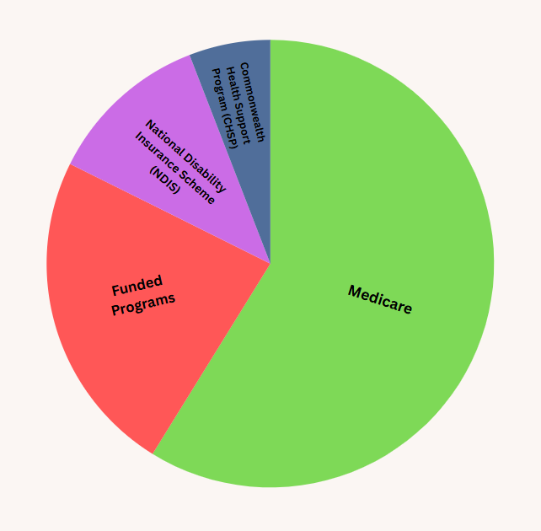






The walu-win Centre Income
Notes:
Medicare – This is our main source of income. Both directly claimed through EPC’s and indirectly by ensuring all patients are up to date with their health checks.
RDN – Rural Doctors Network – some of our clinicians are partly funded for a day a week through the rural doctors' network.
SARRAH – Allied Health Assistant Workforce – funding for developing our allied health assistant workforce which I will talk more about later on.
DCJ – Healthy Connections Program
PHN – Healthy Ageing Program – falls prevention program
NDIS
CHSP – Commonwealth Home Support Program

Slide 16
Patient's Journey to walu-win
Patient presents to OAMS for Health Check (AHC / CDMP)
GP recommends waluwin to patient for lifestyle intervention or physical rehabilitation
GP allocates EPC's to walu-win
Patient books in their appointment with their waluwin Allied Health Professional at Medical reception
Patient attends their appointment at waluwin
Internal referring on to other AHP's
Independent access to walu-win for unsupervised sessions.
AHP follow up / program review
Patient booked in for follow up with GP for GPMP Reviews and AHC's
Notes:
1. Initial Health Check: Patient presents to OAMS for a Health Check (AHC/CDMP).
2. GP Recommendation: GP refers the patient to walu-win for lifestyle intervention or physical rehabilitation.
3. EPC Allocation: GP allocates EPCs to staff (up to 10 combined under AHC/GPMP or 5 under GPMP only).
4. Booking: Patient books an appointment with an Allied Health Professional (AHP) at Medical Reception.
5. Appointment: Patient attends their appointment at walu-win.
6. Internal Referrals: Potential referral to other AHPs (e.g., Exercise Physiologist, Dietitian).
7. Independent Access: After a few supervised sessions, patient may access the exercise room unsupervised following a prescribed exercise program
8. Follow-Up: AHP conducts follow-up care and reviews program
9. Ongoing GP Support: Patient continues to have regular GPMP reviews and AHCs with the GP.

Slide 17


Slide 18
Multidisciplinary Approach to Healthcare
Patient
GP
Exercise Physiologist
Dietitian
Nurse / AHP
Psychologist
AOD Peer Worker
Physiotherapist
Support Workers
Client Centred Approach
‘One stop shop’
Improve in patient outcomes
Notes:
Client Centred Approach – we all work with one another to help improve outcomes for the patient.
One stop shop – we have everyone on site that the patient may need. From the GPs and nurses to our allied health professionals, full mental health team and visiting allied health such as optometrist, hearing, podiatirist, Womens health
This integrated care model leads to better coordination, more convenient access to care, and ultimately improved patient outcomes.

Slide 19

Allied Health Assistant Project
Notes:
One of our funded programs is developing an allied health assistant workforce, and this project is funded through SARRAH – which stands for Services for Australian rural and remote allied health.

Slide 20
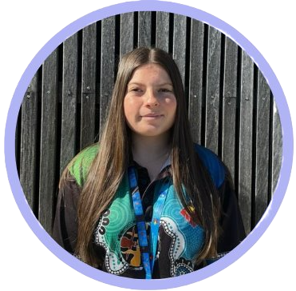
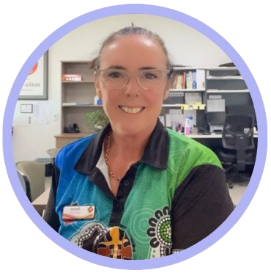
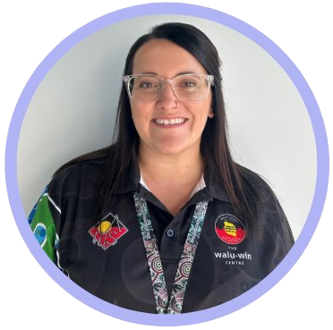
Meet our AHA's:
Ashley
Rachel
Katrina
Notes:
Id like to introduce our AHA’s. We have Ashley, Rachel and Katrina.

Slide 21
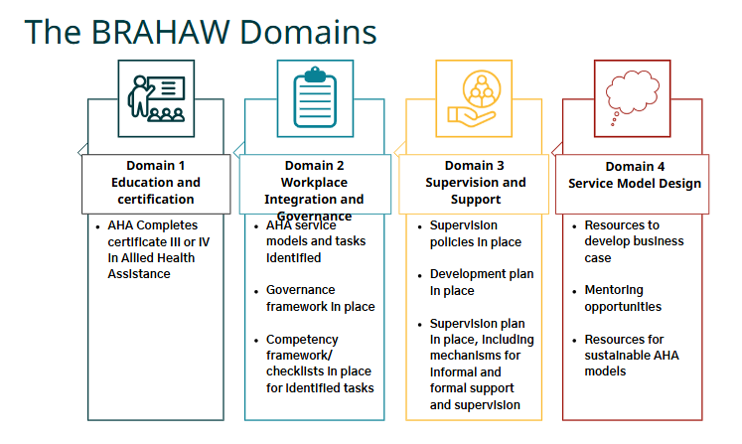

Allied Health Assistant Model
SARRAH: Services for Australian Rural and Remote Allied Health
BRAHAW: Building the Rural and Remote Allied Health Assistant workforce
Design and implementation of an Allied Health Assistant workforce within a multidisciplinary team through the BRAHAW project by SARRAH.
Notes:
We would like to talk about the BRAHAW model, which stands for Building the Rural and Remote Allied Health Assistant Workforce. It's a project by SARRAH—the Services for Australian Rural and Remote Allied Health—aimed at designing and implementing an Allied Health Assistant workforce in multidisciplinary teams.
At the heart of the model are four key domains:
1st domain -. Education and Certification
Allied Health Assistants (AHAs) are required to complete a Certificate III or IV in Allied Health Assistance.
2nd domain -. Workplace Integration and Governance
This includes identifying relevant AHA service models and tasks, putting a governance framework in place, and using competency checklists for those tasks.
3rd domain -. Supervision and Support
It involves having clear supervision policies, individual development plans, and structured supervision frameworks—both formal and informal.
4th domain -. Service Model Design
This focuses on sustainability, offering resources to develop business cases, mentoring opportunities, and support for long-term AHA service models.

Slide 22
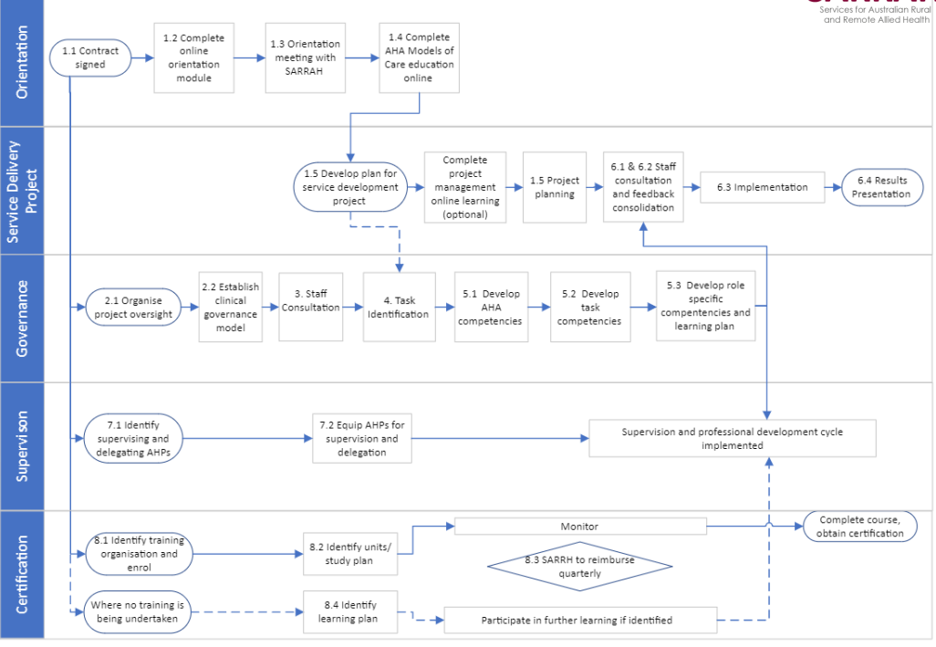
Notes:
This flowchart visualises the step by step process for building the Allied Health Assistant Workforce, and is broken into 5 key areas:
Orientation, Service delivery, project governance, supervision and certification.
For us at OAMS, we are currently sitting here on this chart……… and we are working our way down to supervision and implementation of competency tasks for our AHA’s.

Slide 23
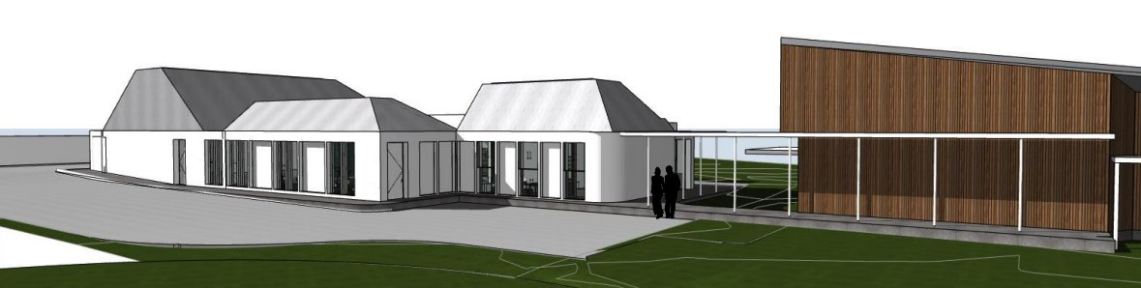
OAMS Hydrotherapy Pool
Completion January 2026
Notes:
Coming Early 2026: is our New Building Expansion!
As previously mentioned, we are excited to share that construction is well underway for the extension of our current facility. This new space will include:
Additional consult rooms to better serve our growing services
A spacious, open-plan exercise area designed for group classes
And a hydrotherapy pool to support a wider range of rehabilitation and wellness services

Slide 24
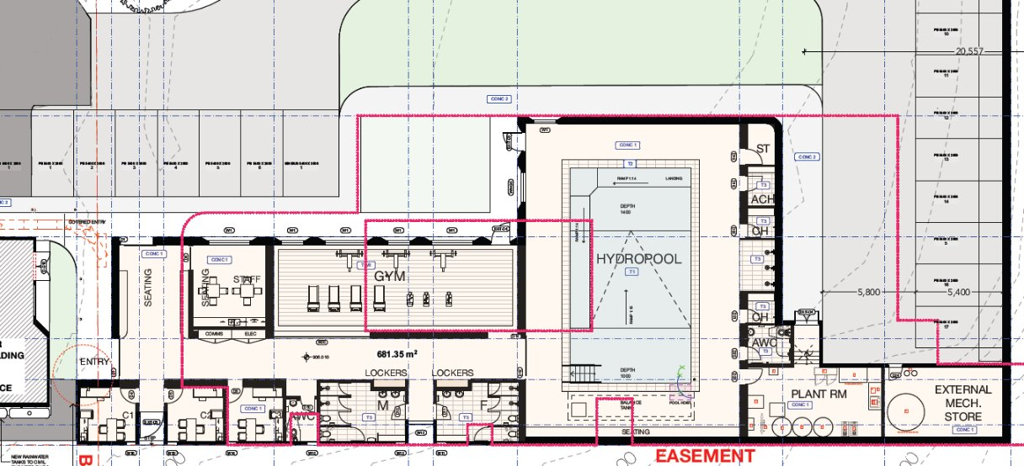
Notes:
This is the design for our new facility. A key feature is the hydrotherapy pool, which will measure approximately 10 metres by 12 metres.
To ensure accessibility for all users, the pool will include three main access points:
A ramp for gradual entry
Stairs with handrails
A ‘Pool Pod’ lift to support individuals with limited mobility
These features reflect our commitment to inclusive and functional design, tailored to meet the diverse needs of our clients.
.

Slide 25


OAMS & CSU Research Project - Hydrotherapy
Objective:
To develop a theory informed project logic model for walu-win, specifically for hydrotherapy services
Purpose:
To give walu-win a consistent, logical, sustainable and evidence-based approach to the funding and delivery of services and/or programs, initially for hydrotherapy, but also adaptable for future initiatives
Lead at OAMS by Dr Elizabeth Pressick PhD, ESSAM AEP ASpS2 AES
Notes:
We have partnered with Charles Sturt University to undertake research aimed at informing the design and delivery of our hydrotherapy services.
This collaborative project has included:
Focus groups with community members
Consultations with internal staff
Interviews with external stakeholders
The insights gained through this research will play a vital role in ensuring our services are effective, sustainable, and aligned with the evolving needs of our clients and broader community.

Slide 26
Preliminary Findings
Cultural Safety
Funding
Staffing
Programs
Sustainability
Notes:
From our focus groups and interviews, five main themes emerged that will guide our service development and delivery at Waluwin:
1. Cultural Safety
Tailored Services:
Men and Women-only classes/sessions
Appropriate swimwear options
Gender-specific staff for comfort and cultural sensitivity
2. Funding
Hydrotherapy Pool comes with increased costs:
Group services may have small out-of-pocket expenses ($5–10 per person per class)
Individual sessions can be covered by Medicare, NDIS, or CHSP funding
3. Staffing
Qualified Staff:
Ensure we have enough staff with appropriate qualifications to safely manage the hydrotherapy pool
4. Programs
Designing and delivering diverse services, including:
Group Aqua Classes
Aqua Zumba
Individual Rehabilitation Sessions
Learn to Swim programs
Athlete Recovery (supported by OAMS sponsorship)
5. Sustainability
Long-Term Viability:
Charge a small out-of-pocket fee to cover costs
Rent the pool to external providers (e.g., other physios, exercise physiologists)
Host training organizations for hydrotherapy training opportunities

Slide 27

Hydrotherapy Service
Individual Rehabilitation Sessions (Physiotherapy & Exercise Physiology)
  Primary OAMS clients
  NDIS Participants
  CHSP Participants
Hydrotherapy Programs:
  Learn to Swim (Children & Adults)
  Aqua Fitness Classes
  Aqua Zumba Classes
  Sponsored Sporting Team Recovery Sessions
Professional Development Opportunities
Hiring of Facility for External Stakeholders
Notes:
Based on the research interviews with Charles Sturt University (CSU), we are exploring the potential to offer the following services:
Individual rehabilitation sessions
Hydrotherapy programs
Professional Development Opportunities
and hiring of the facility to external stakeholders
These new services will help expand our offerings and continue to meet the evolving needs of our community.

Slide 28
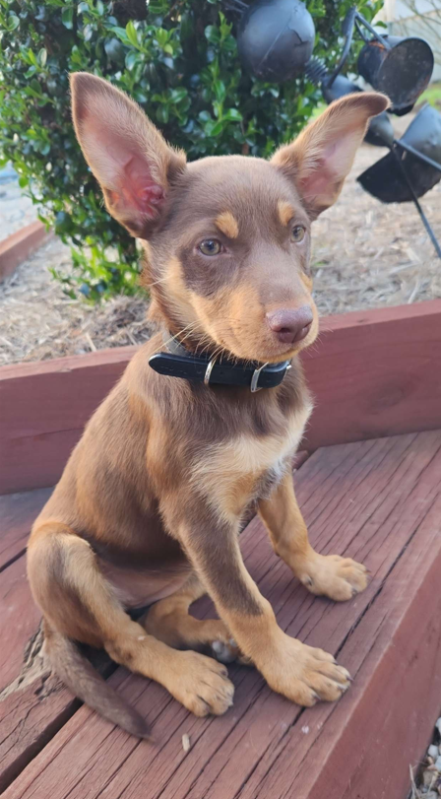
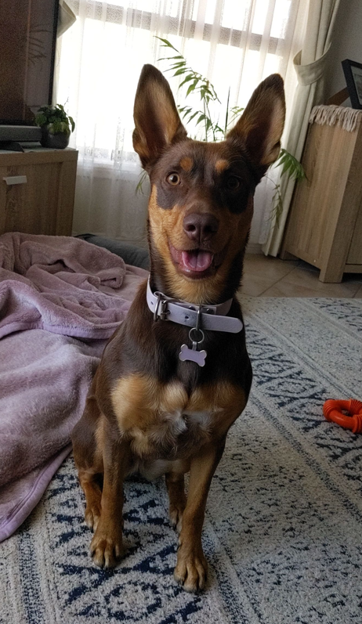
Thank you for listening!
Any Questions?
Meet Ruby:

Slide 29
THANK YOU
Joshua Mitchell
Accredited Exercise Physiologist / walu-win Manager
Ashley Wood
Allied Health Assistant Trainee

