Slide 1
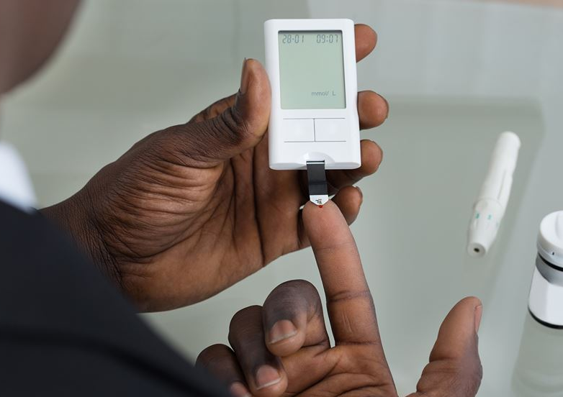
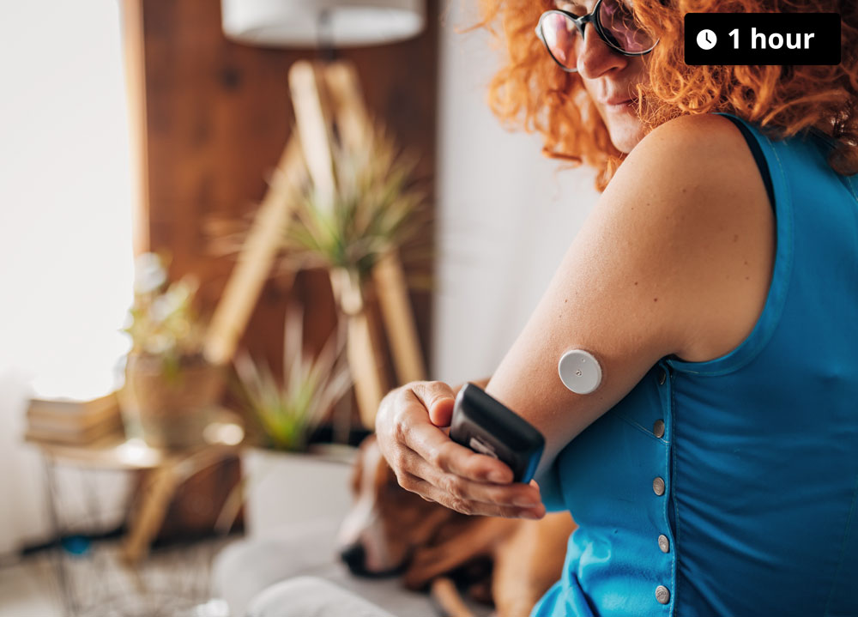
Comparison of Continuous Glucose Monitoring (CGM) vs Capillary Blood Testing

Slide 2
What we know
Diabetes management requires frequent glucose monitoring
Traditional method: finger prick blood testing
Emergence of CGM devices offering real-time glucose trends e.g. Freestyle Libre sensors
User-friendly insulin delivery systems

Slide 3
Clinical Trial
University of Melbourne - Flash Glucose Monitoring Study
Participants: Aboriginal and Torres Strait Islander adults with type 2 diabetes on injectable therapy and HbA1c ≥ 7.0%.
How it works: Randomised control trial where half of the participants wear a CGM monitor whilst the rest continue capillary glucose monitoring
Duration: 6 months
Aim: Assess the effectiveness CGM monitoring vs Capillary glucose monitoring
Jeff brad/ brian dinham- CGM???
Kerri ann cook – finger prick

Slide 4
Preliminary Observations
CGM offers continuous feedback, alerts for hypo/hyperglycemia
Users report improved confidence in managing blood glucose
Reduced frequency of finger pricking improves comfort and adherence
Better understanding of patterns and food/exercise impact on glucose

Slide 5
Summary of Findings (No Data)
CGM appears to improve glycaemic control in daily life
Enhances proactive management by providing trends
May reduce hypoglycaemic episodes and improve quality of life
Still some barriers: cost, access, learning curve

Slide 6
Clinical & Lifestyle Implications
CGM can support individualised care plans
Potential to reduce long-term complications
Useful for education and engagement in self-management
Could lead to broader integration into standard care protocols

Slide 7
Real Time Data- Patient 1
Date 02/09/24 28/10/24 17/02/25
Time F-Fast 0736 F 0741 F 0737 F
Lab ID 852170363 852697863 852698185
Units Reference
HbA1c (IFCC) H 102 mmol/mol (20-38)
HbA1c (NGSP) H 11.5 % (4.0-5.6)
HbA1c (IFCC) H 78 H 52 mmol/mol (20-38)
HbA1c (NGSP) H 9.3 H 6.9

Slide 8
Summary
🔹 Real-Time Data, Real-Time Action
CGM provides continuous, dynamic glucose readings, allowing for immediate lifestyle or treatment adjustments.
🔹 Better Glycaemic Control
Users spend more time within the target glucose range, reducing both hyperglycaemia and hypoglycaemia episodes.
🔹 Informed Lifestyle Choices
Access to glucose trends helps individuals make better decisions around food, activity, and insulin dosing.
🔹 Improved Diet Management
Immediate feedback from CGM supports healthier dietary choices by showing how specific foods affect glucose levels.
🔹 Enhanced Medication Titration
Healthcare providers can use CGM data to fine-tune insulin and other diabetes medications more effectively.
🔹 Quality of Life
Reduced need for frequent finger pricks and improved glucose awareness lead to less anxiety and greater confidence in diabetes self-management.

Slide 9
Thank You
Any Questions?

